Slide 1

AISI439
Indenter radius: 1um 2um 5um 20 um
Constant strain rate 0.1 1/s
For each indenter radius:
a/R=0.2,0.3,0.4 are tested
a: contact radius
R: Indenter radius
1

Slide 2
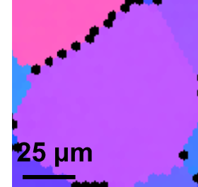
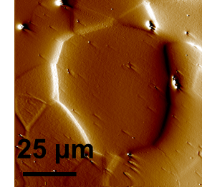
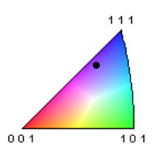
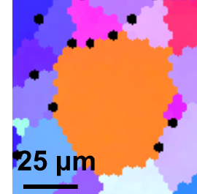
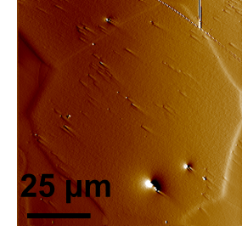
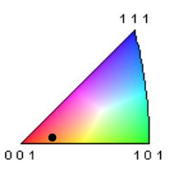
AISI439 - Position
Grain 4833
Grain 4200
1

Slide 3
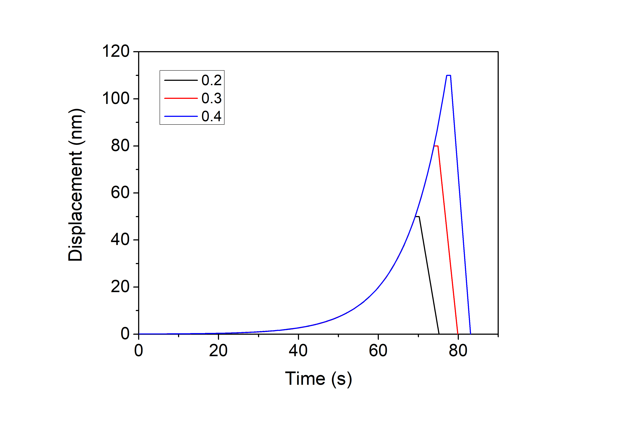
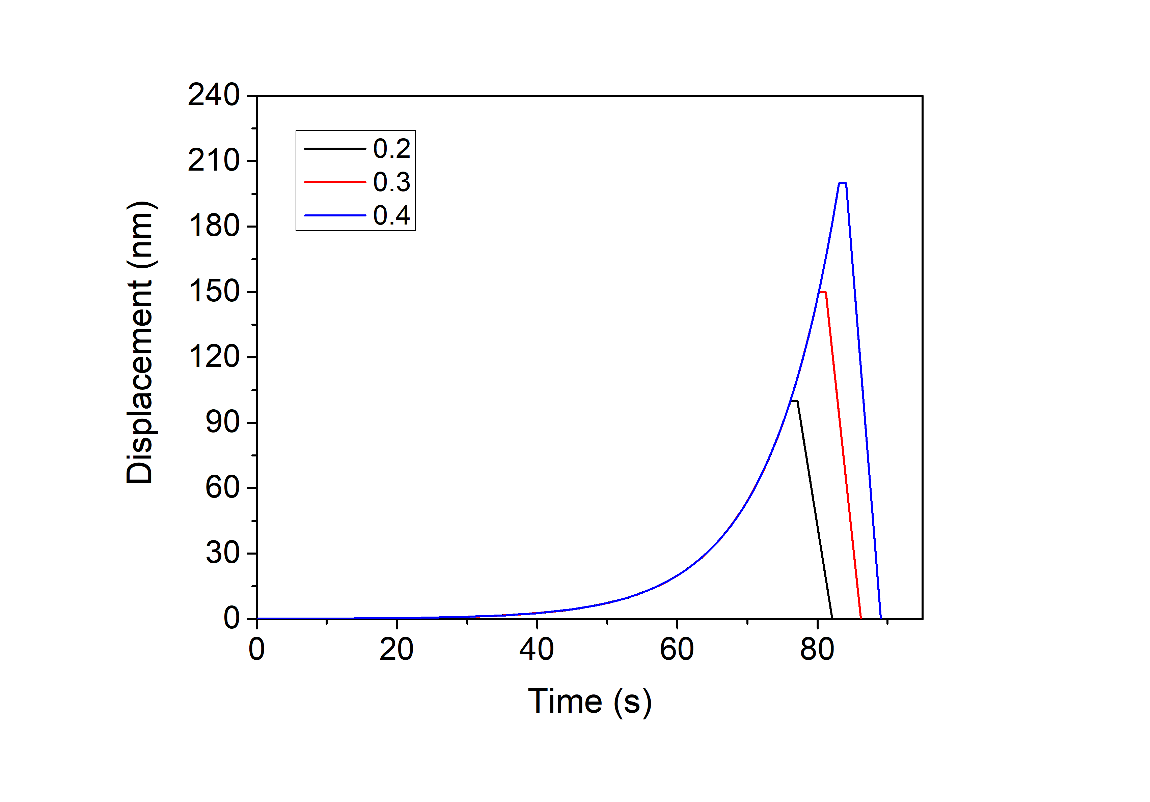
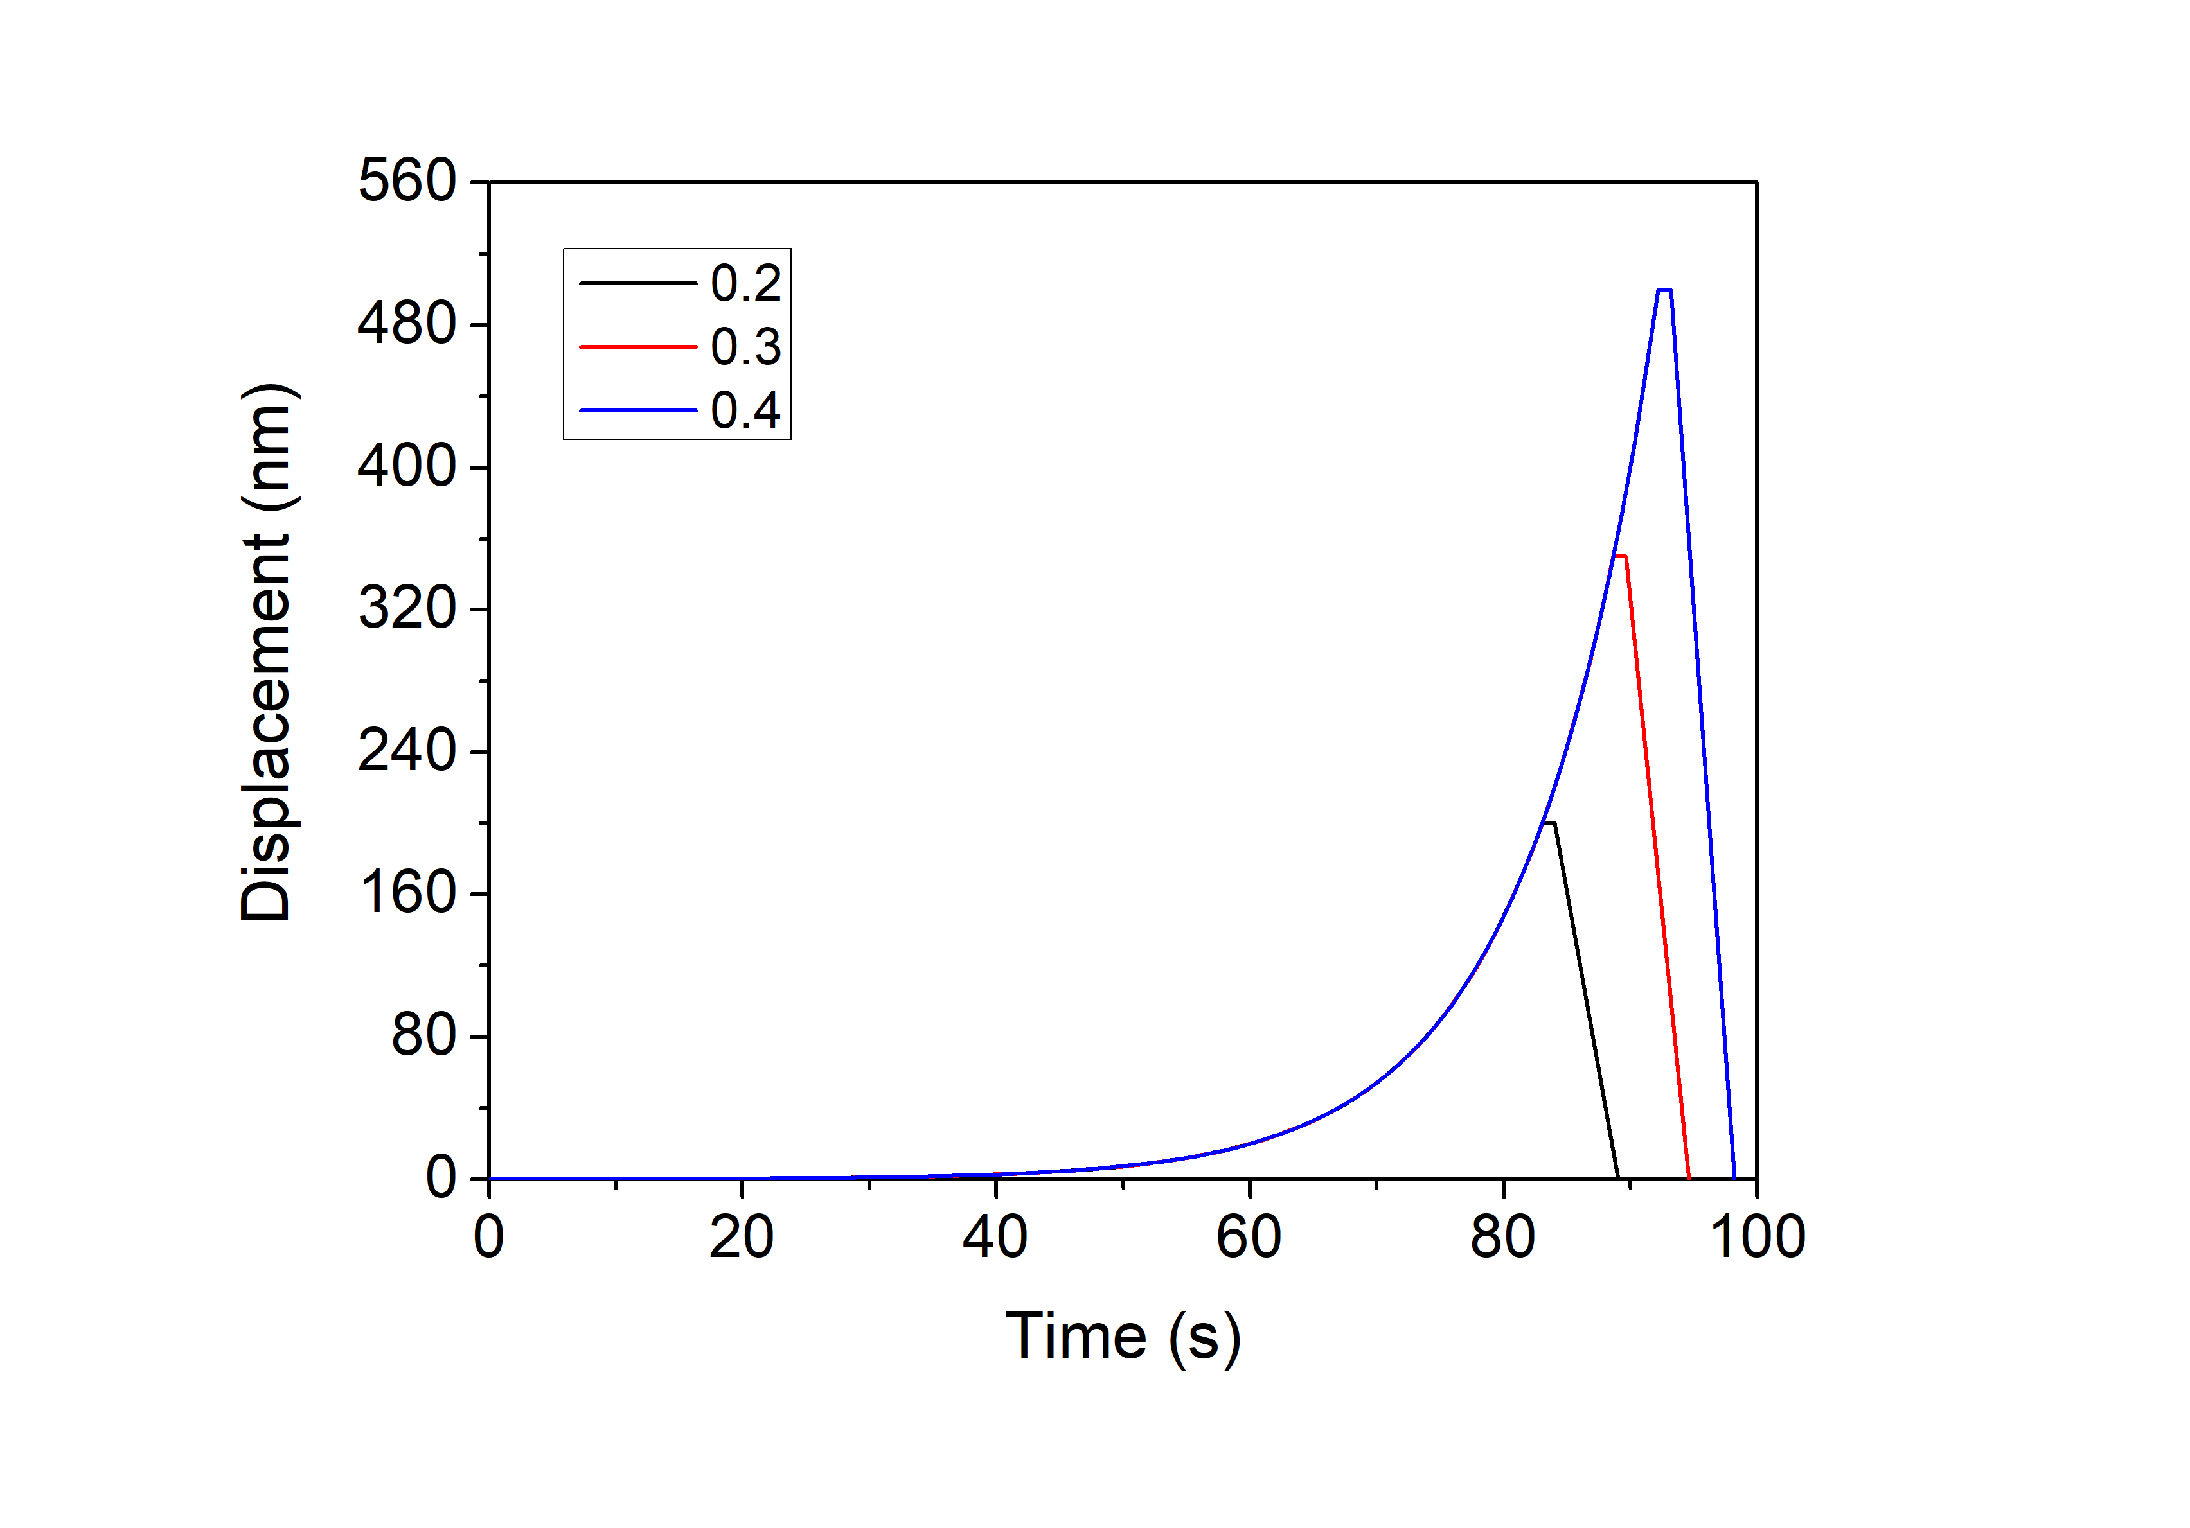
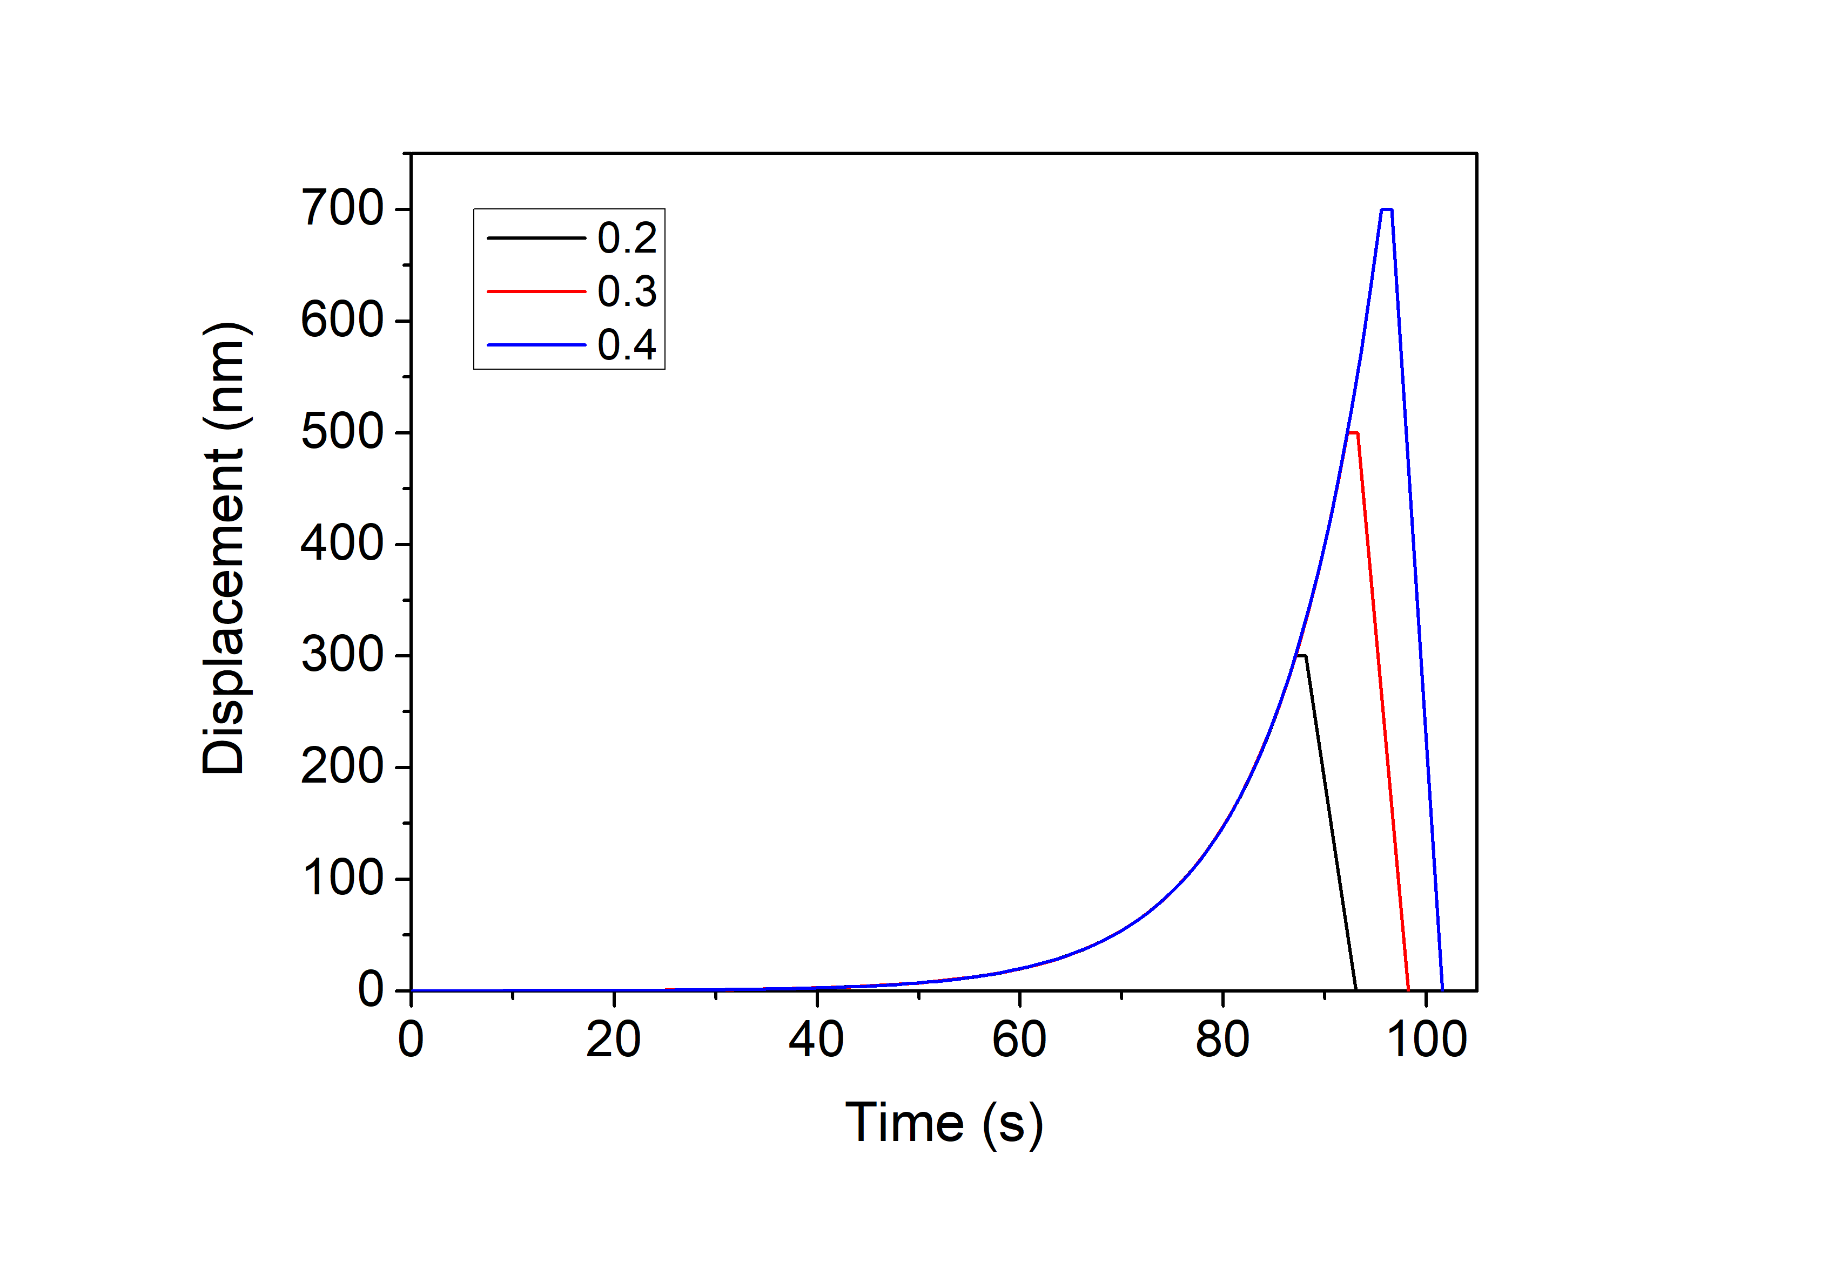
AISI439 – Loading function
1

Slide 4
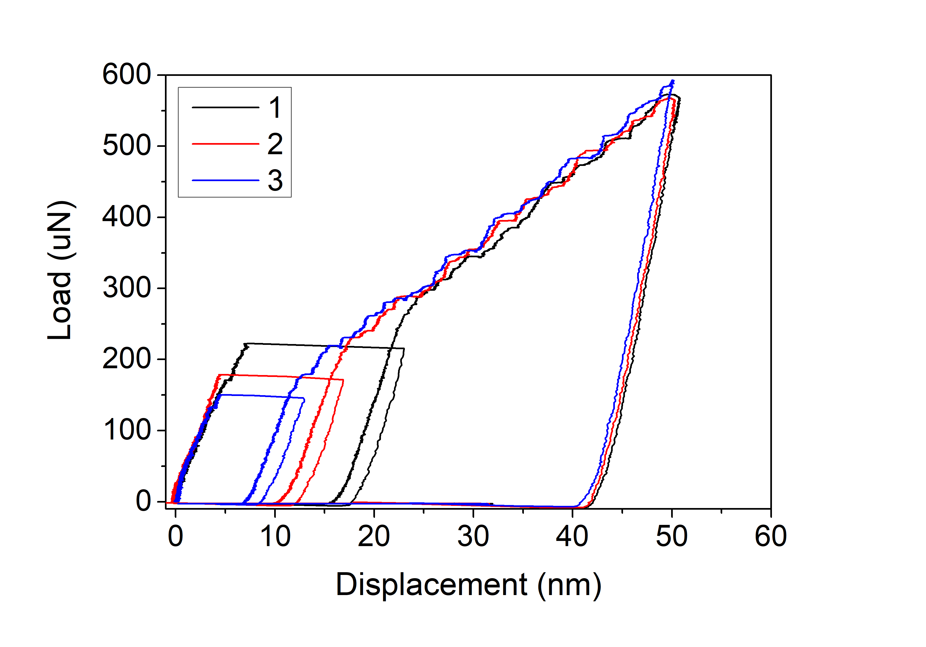
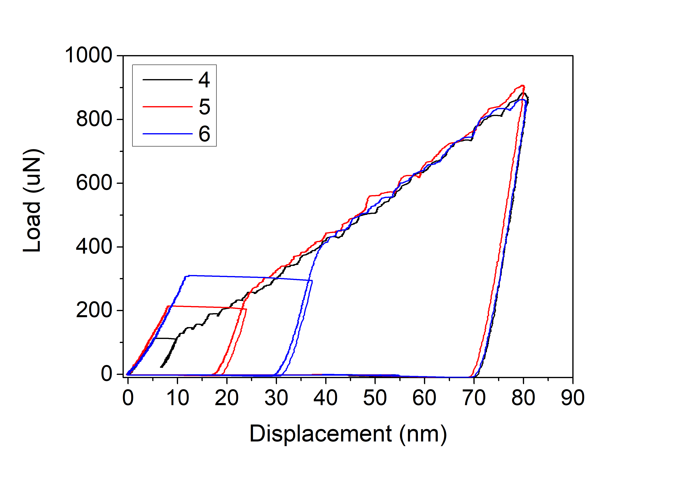
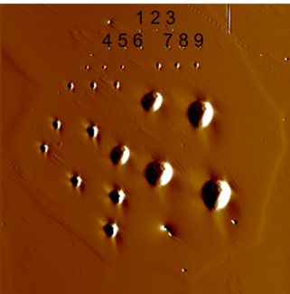
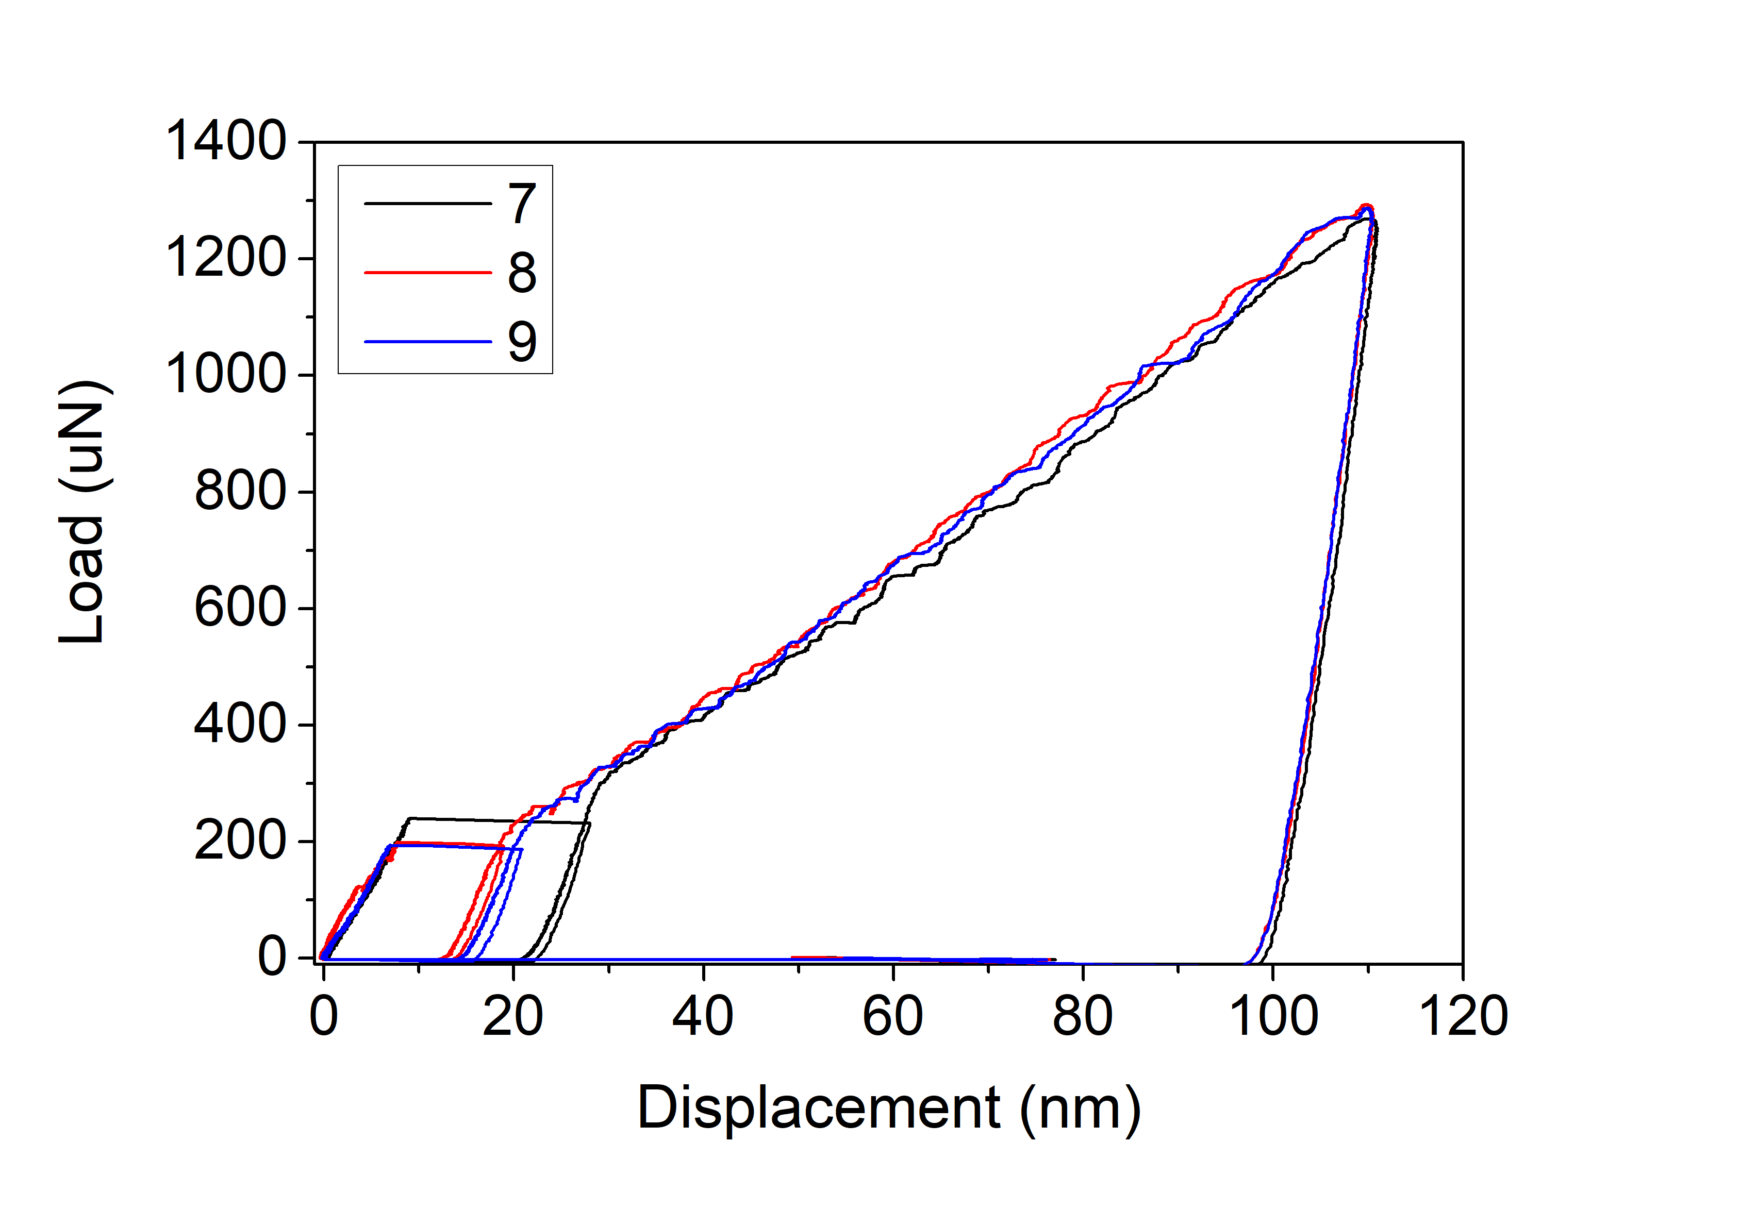
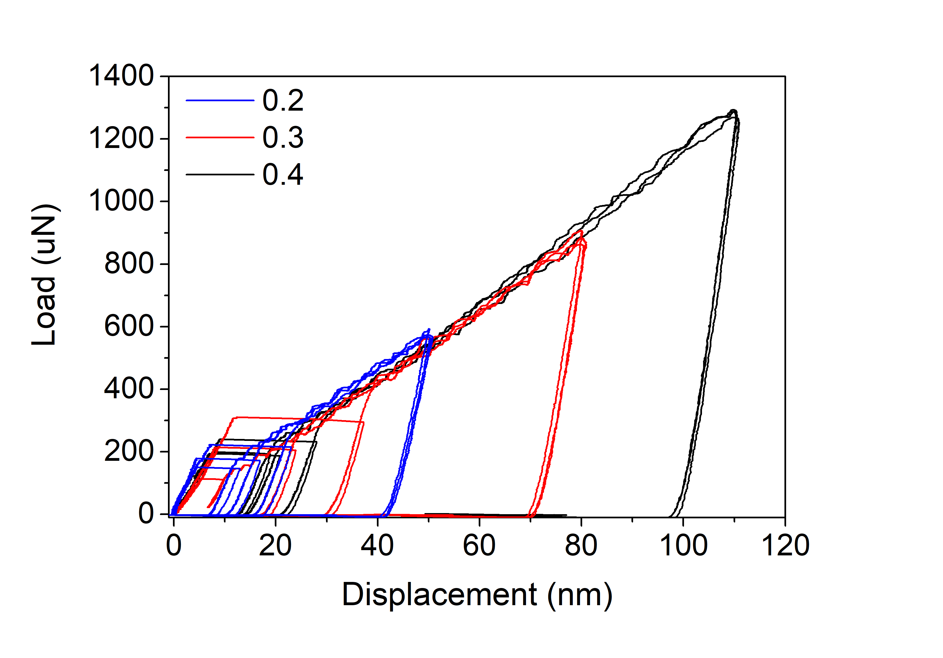
AISI439
Indenter radius 1um
1

Slide 5
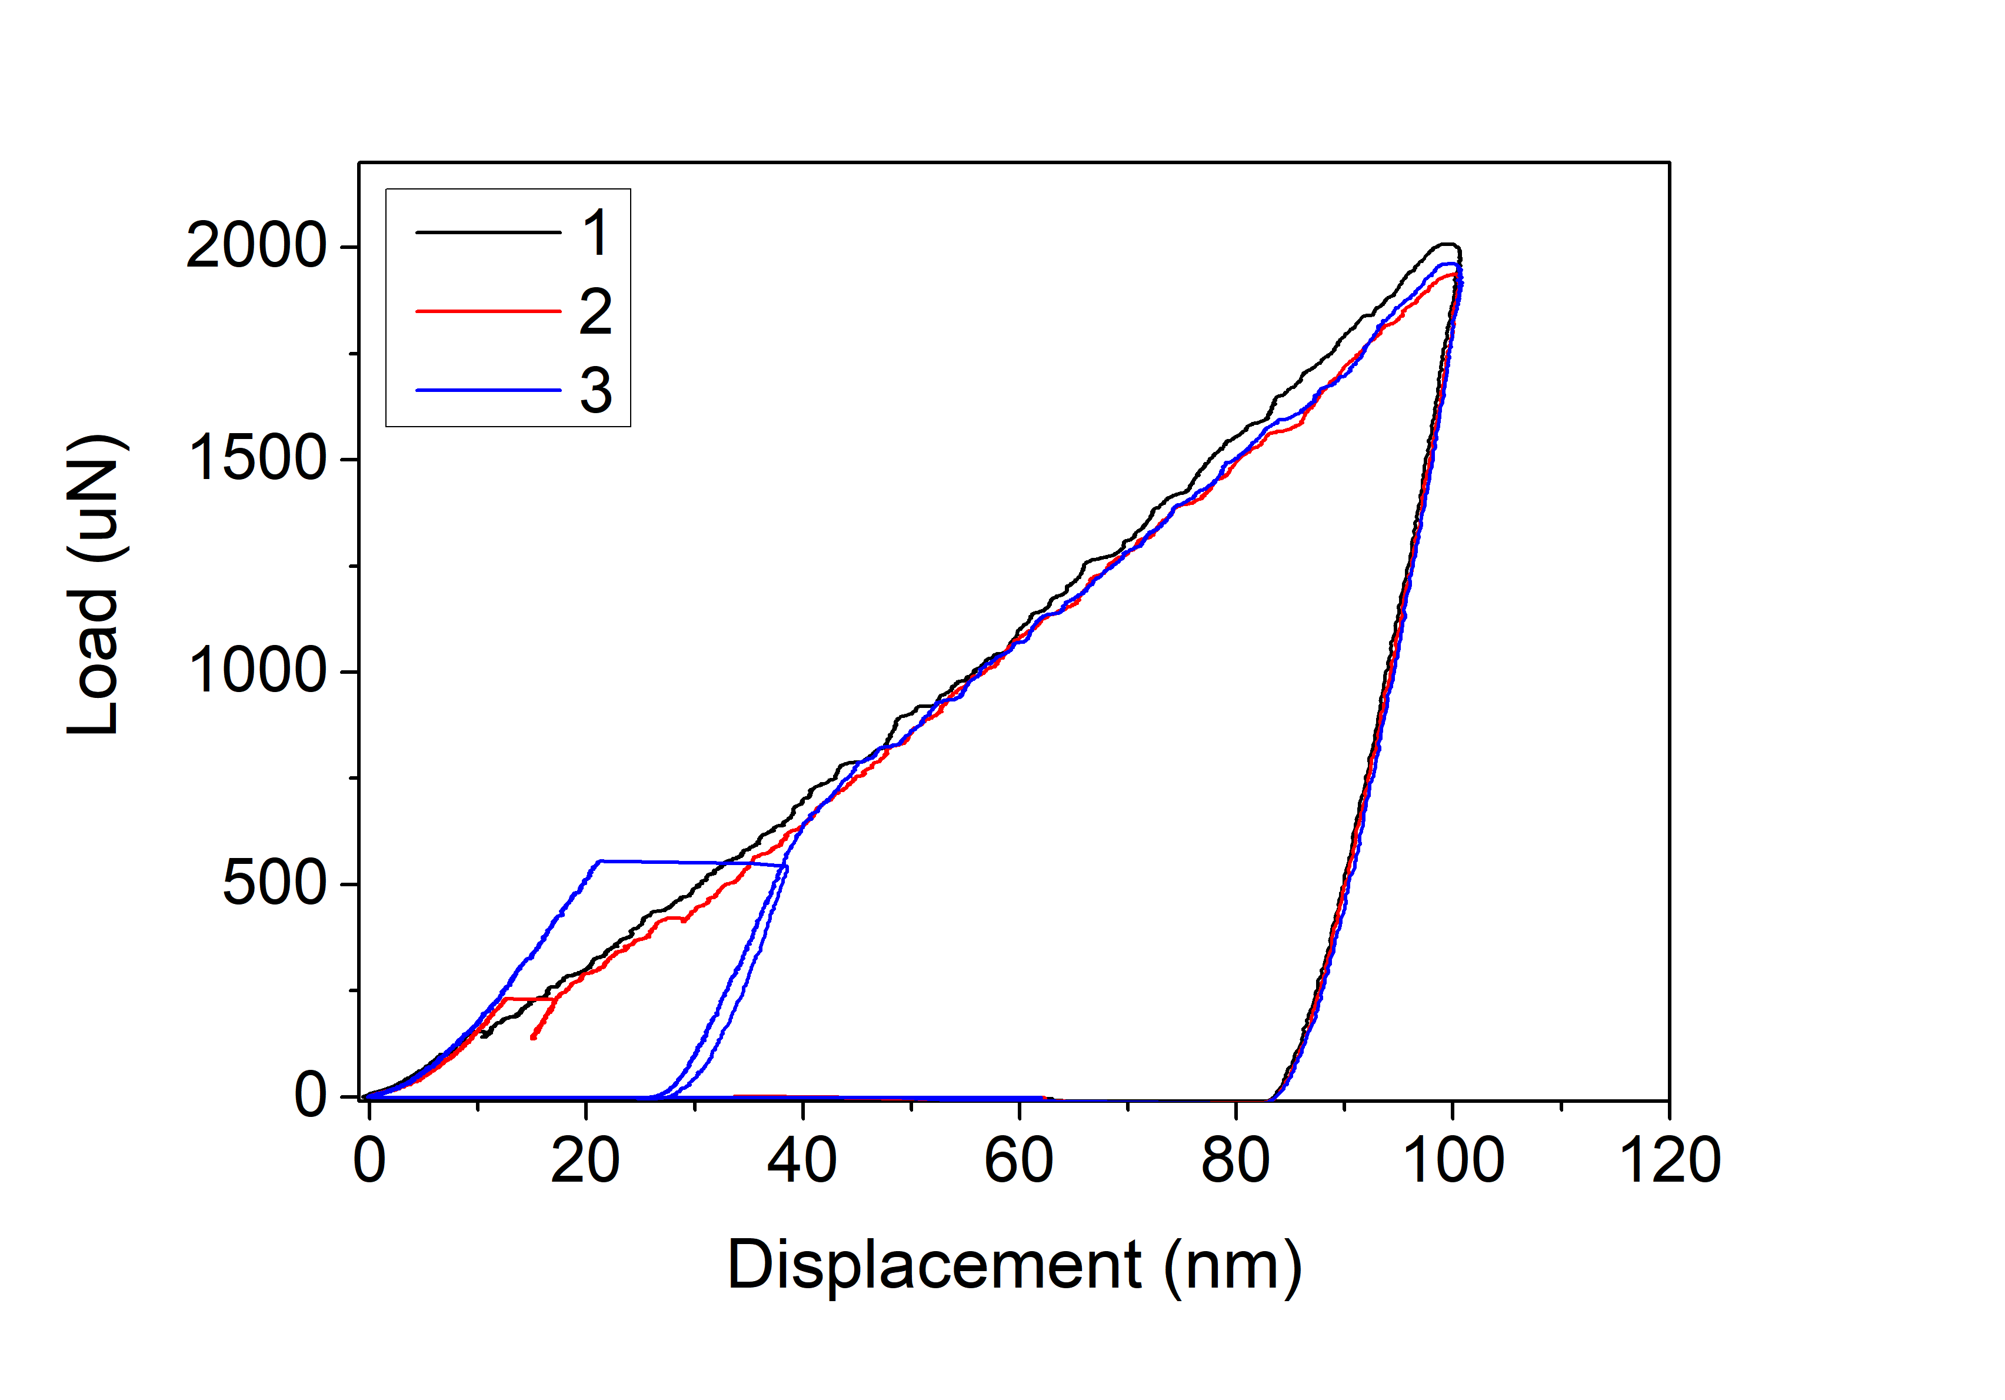
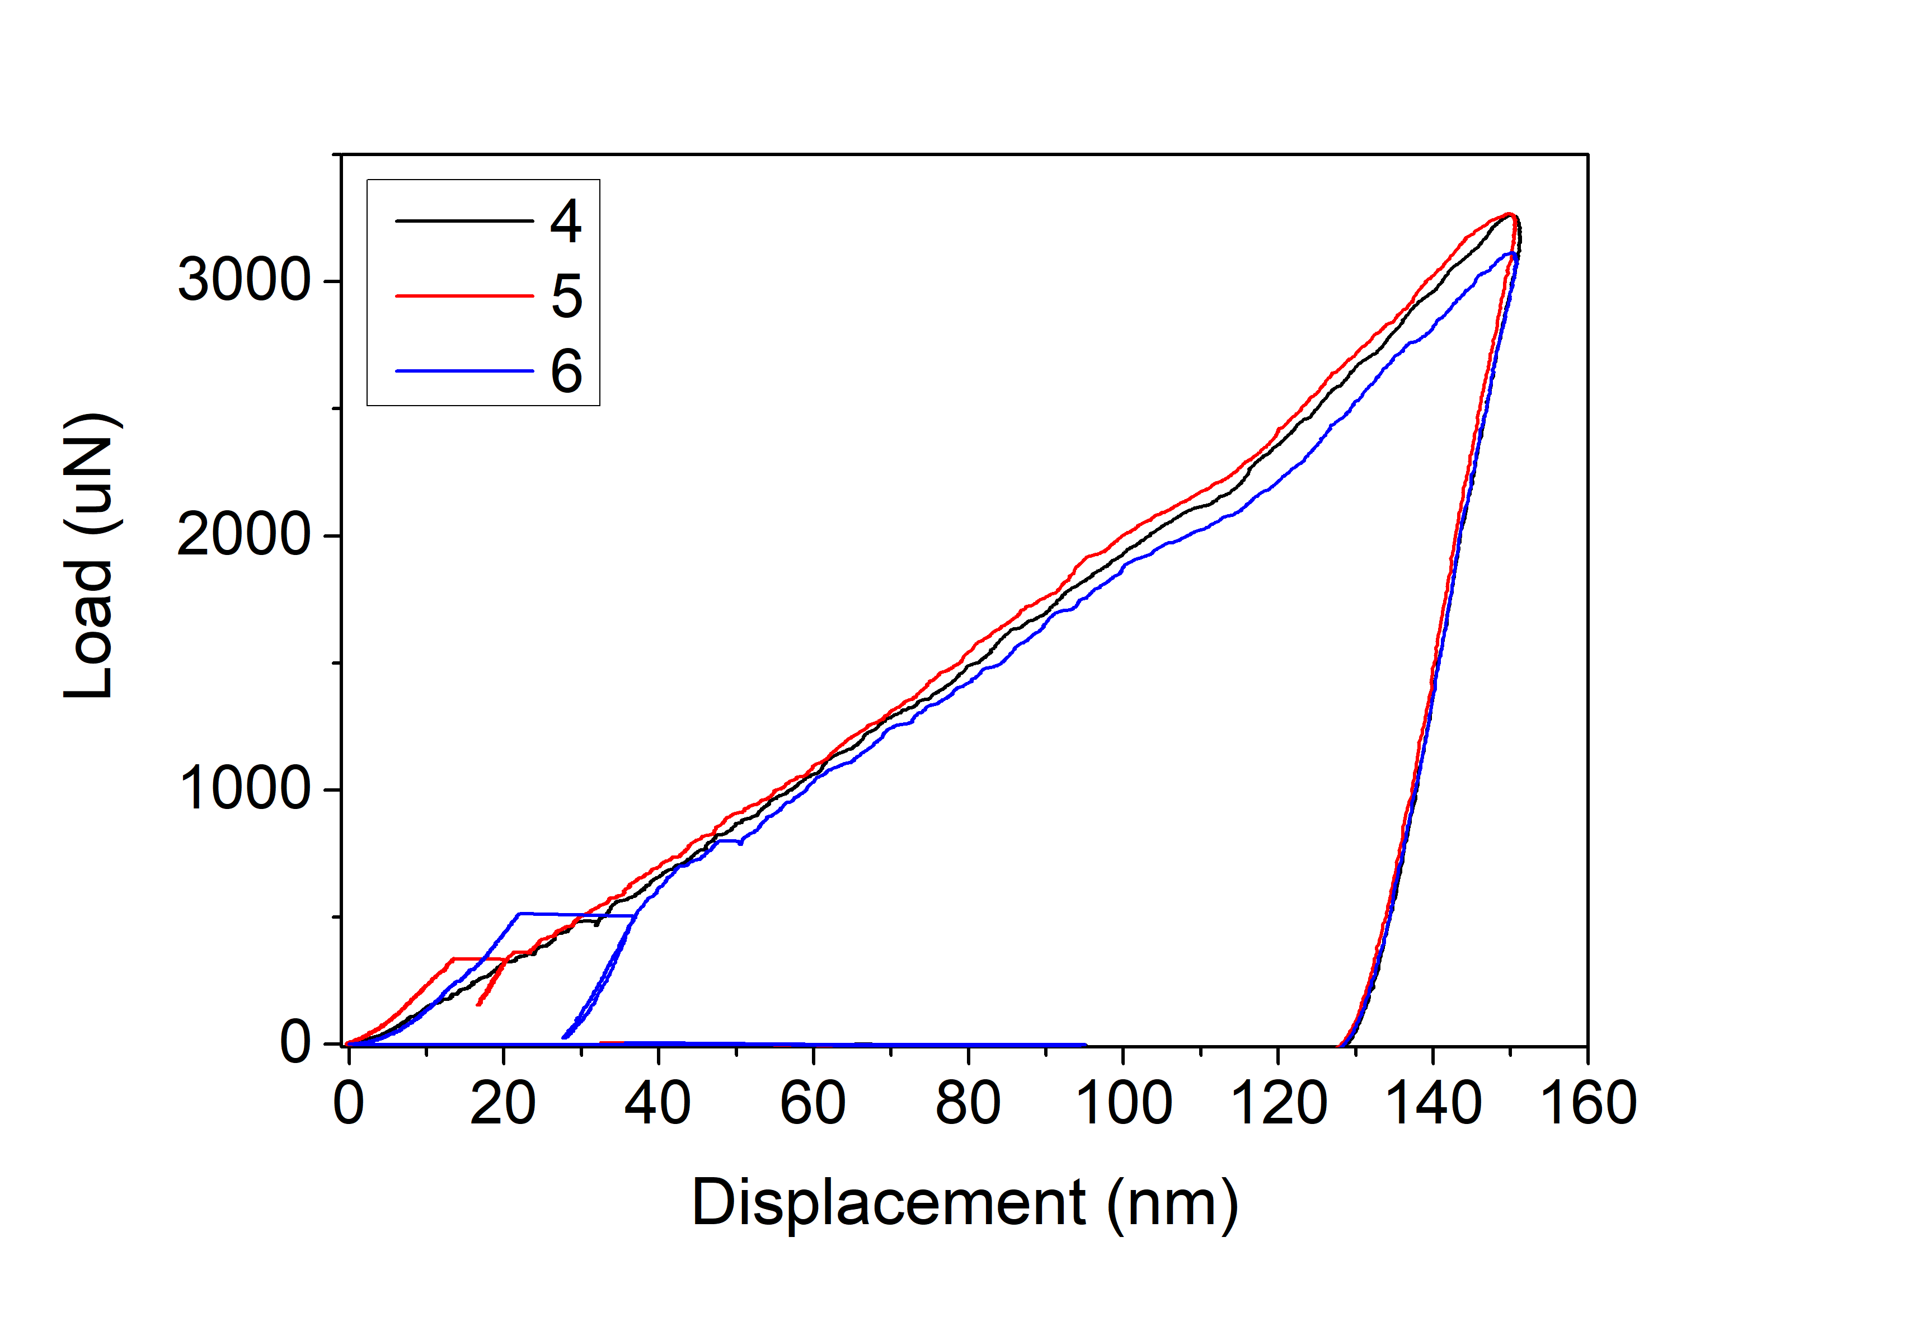
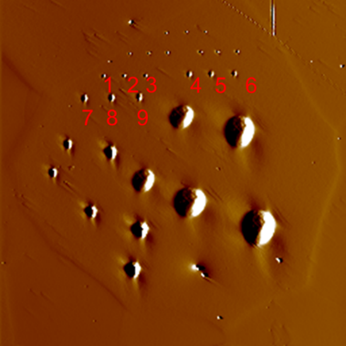
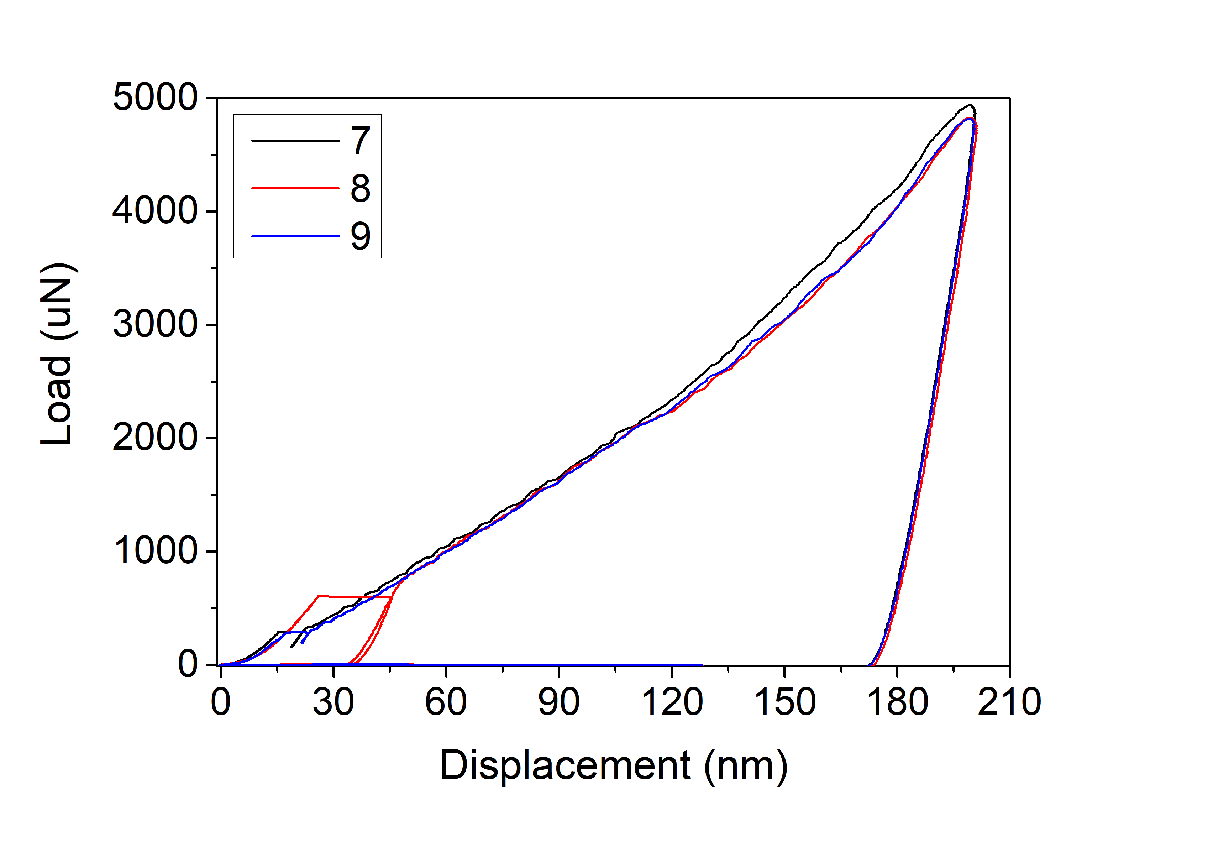
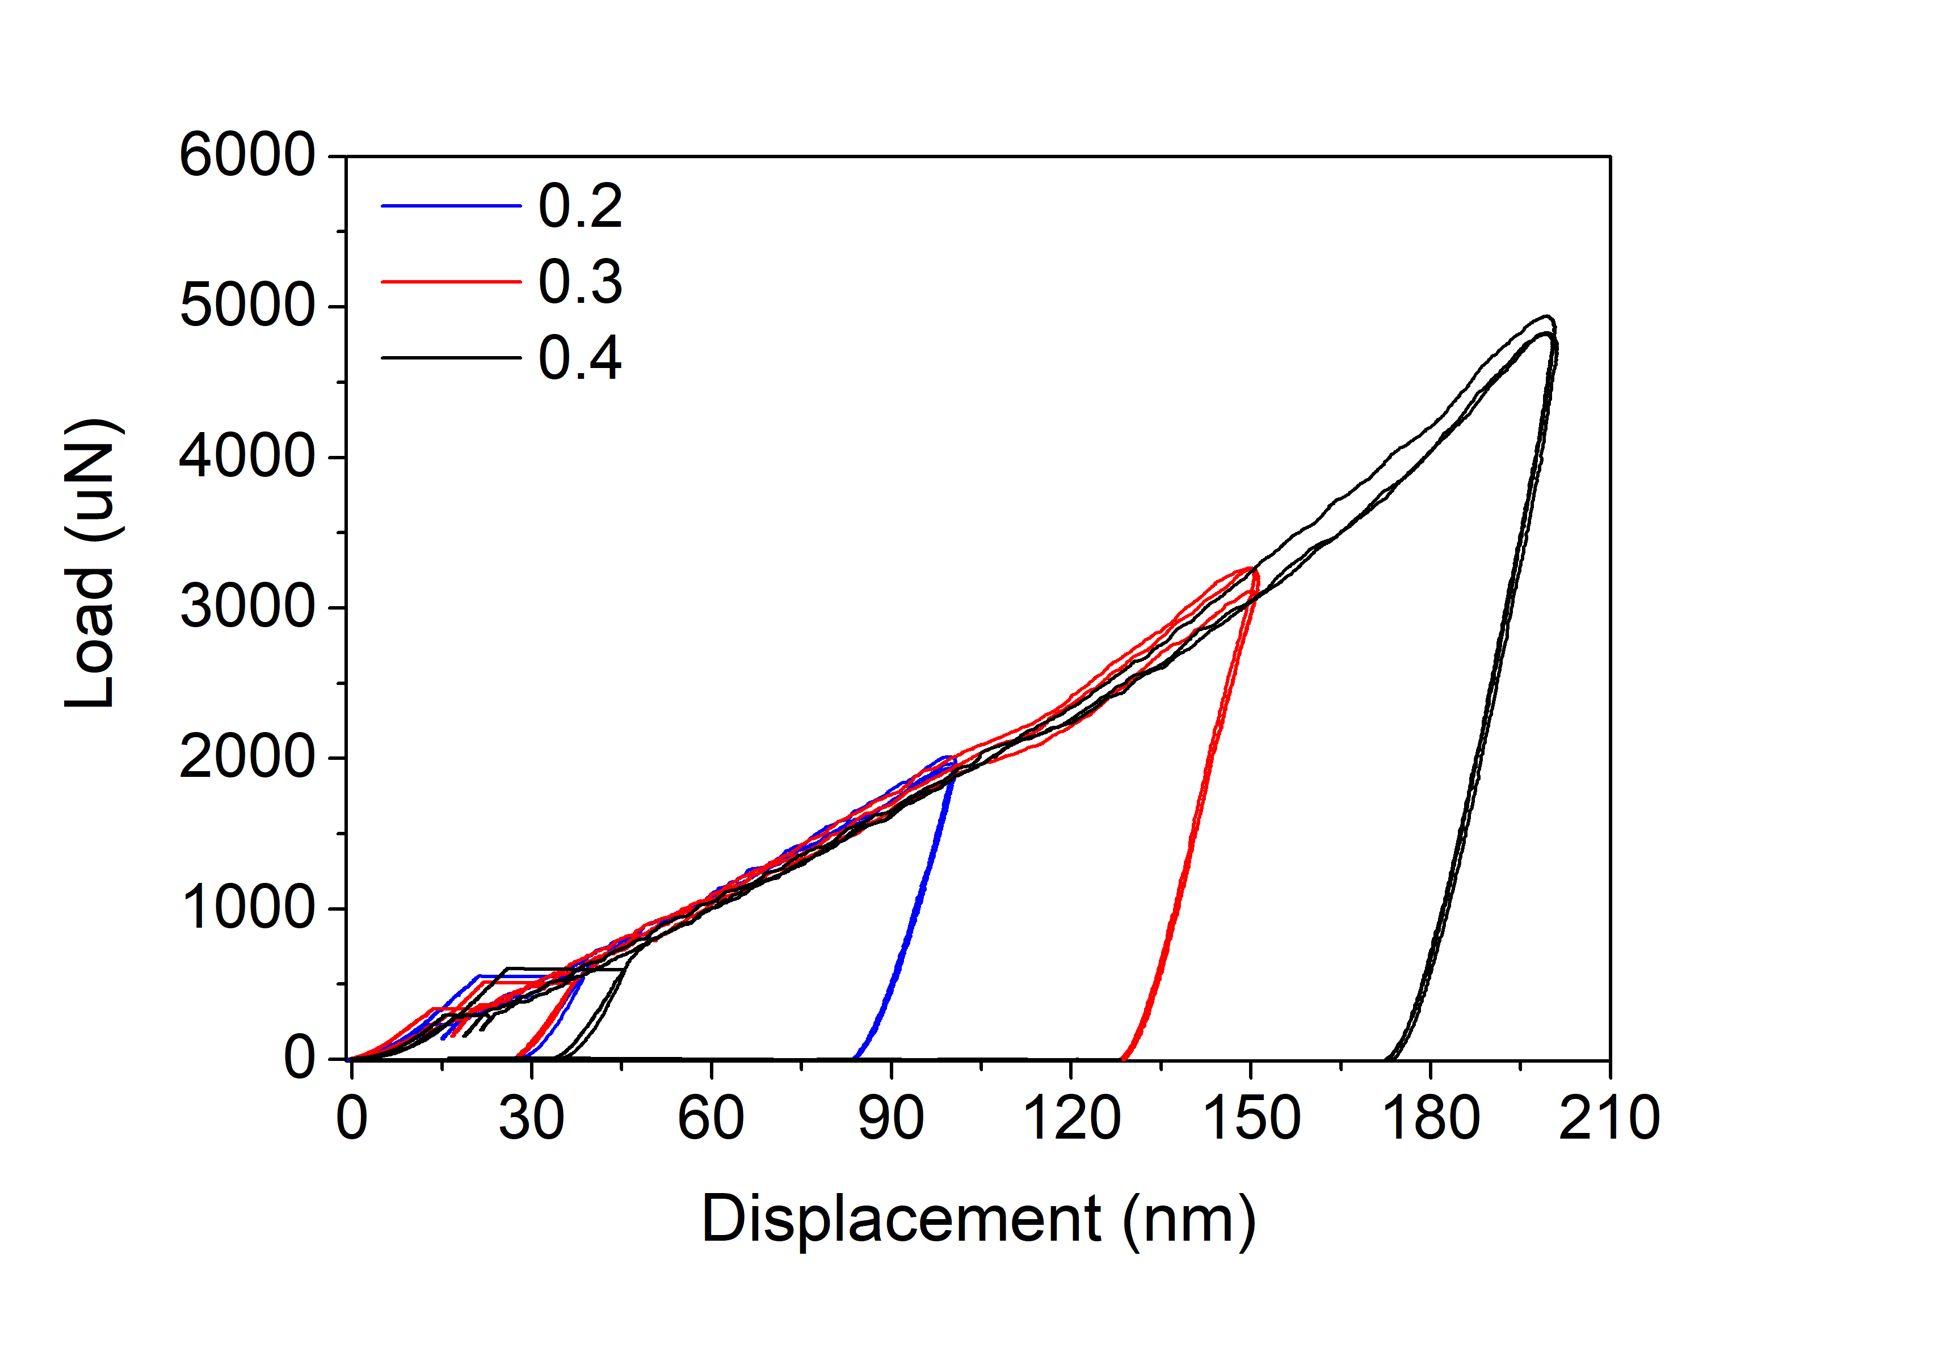
AISI439
Indenter radius 2um
1

Slide 6
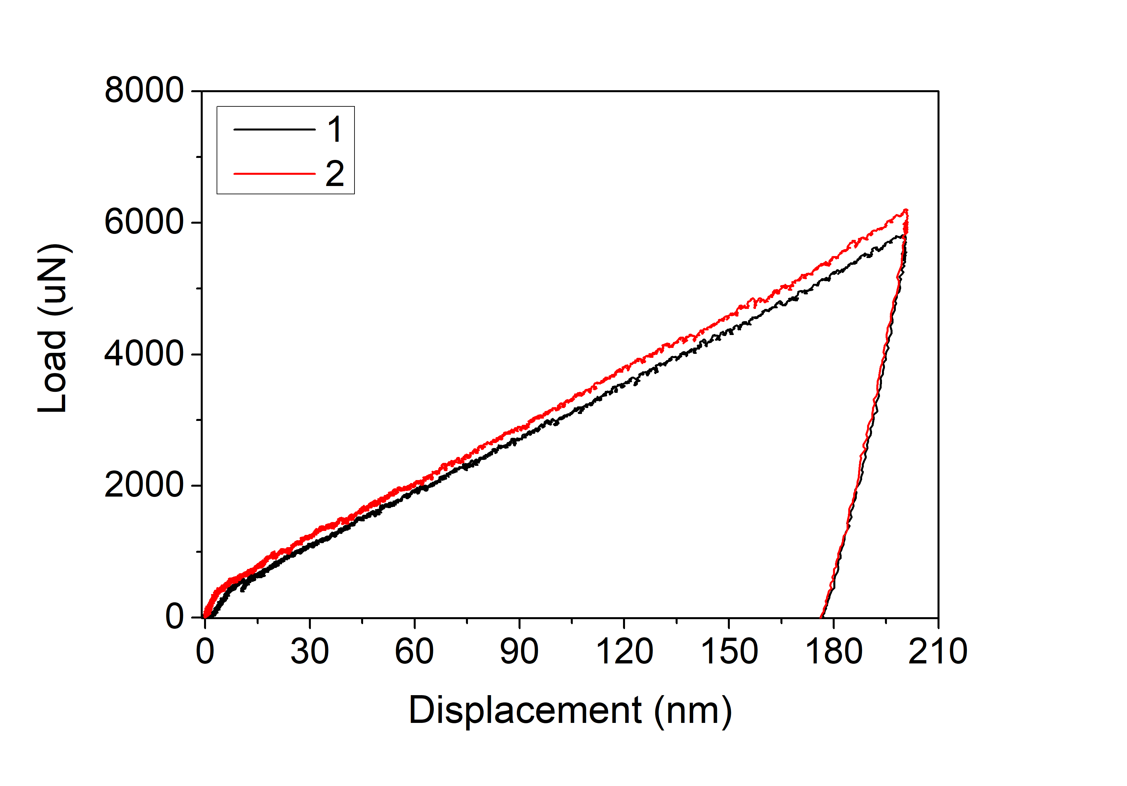
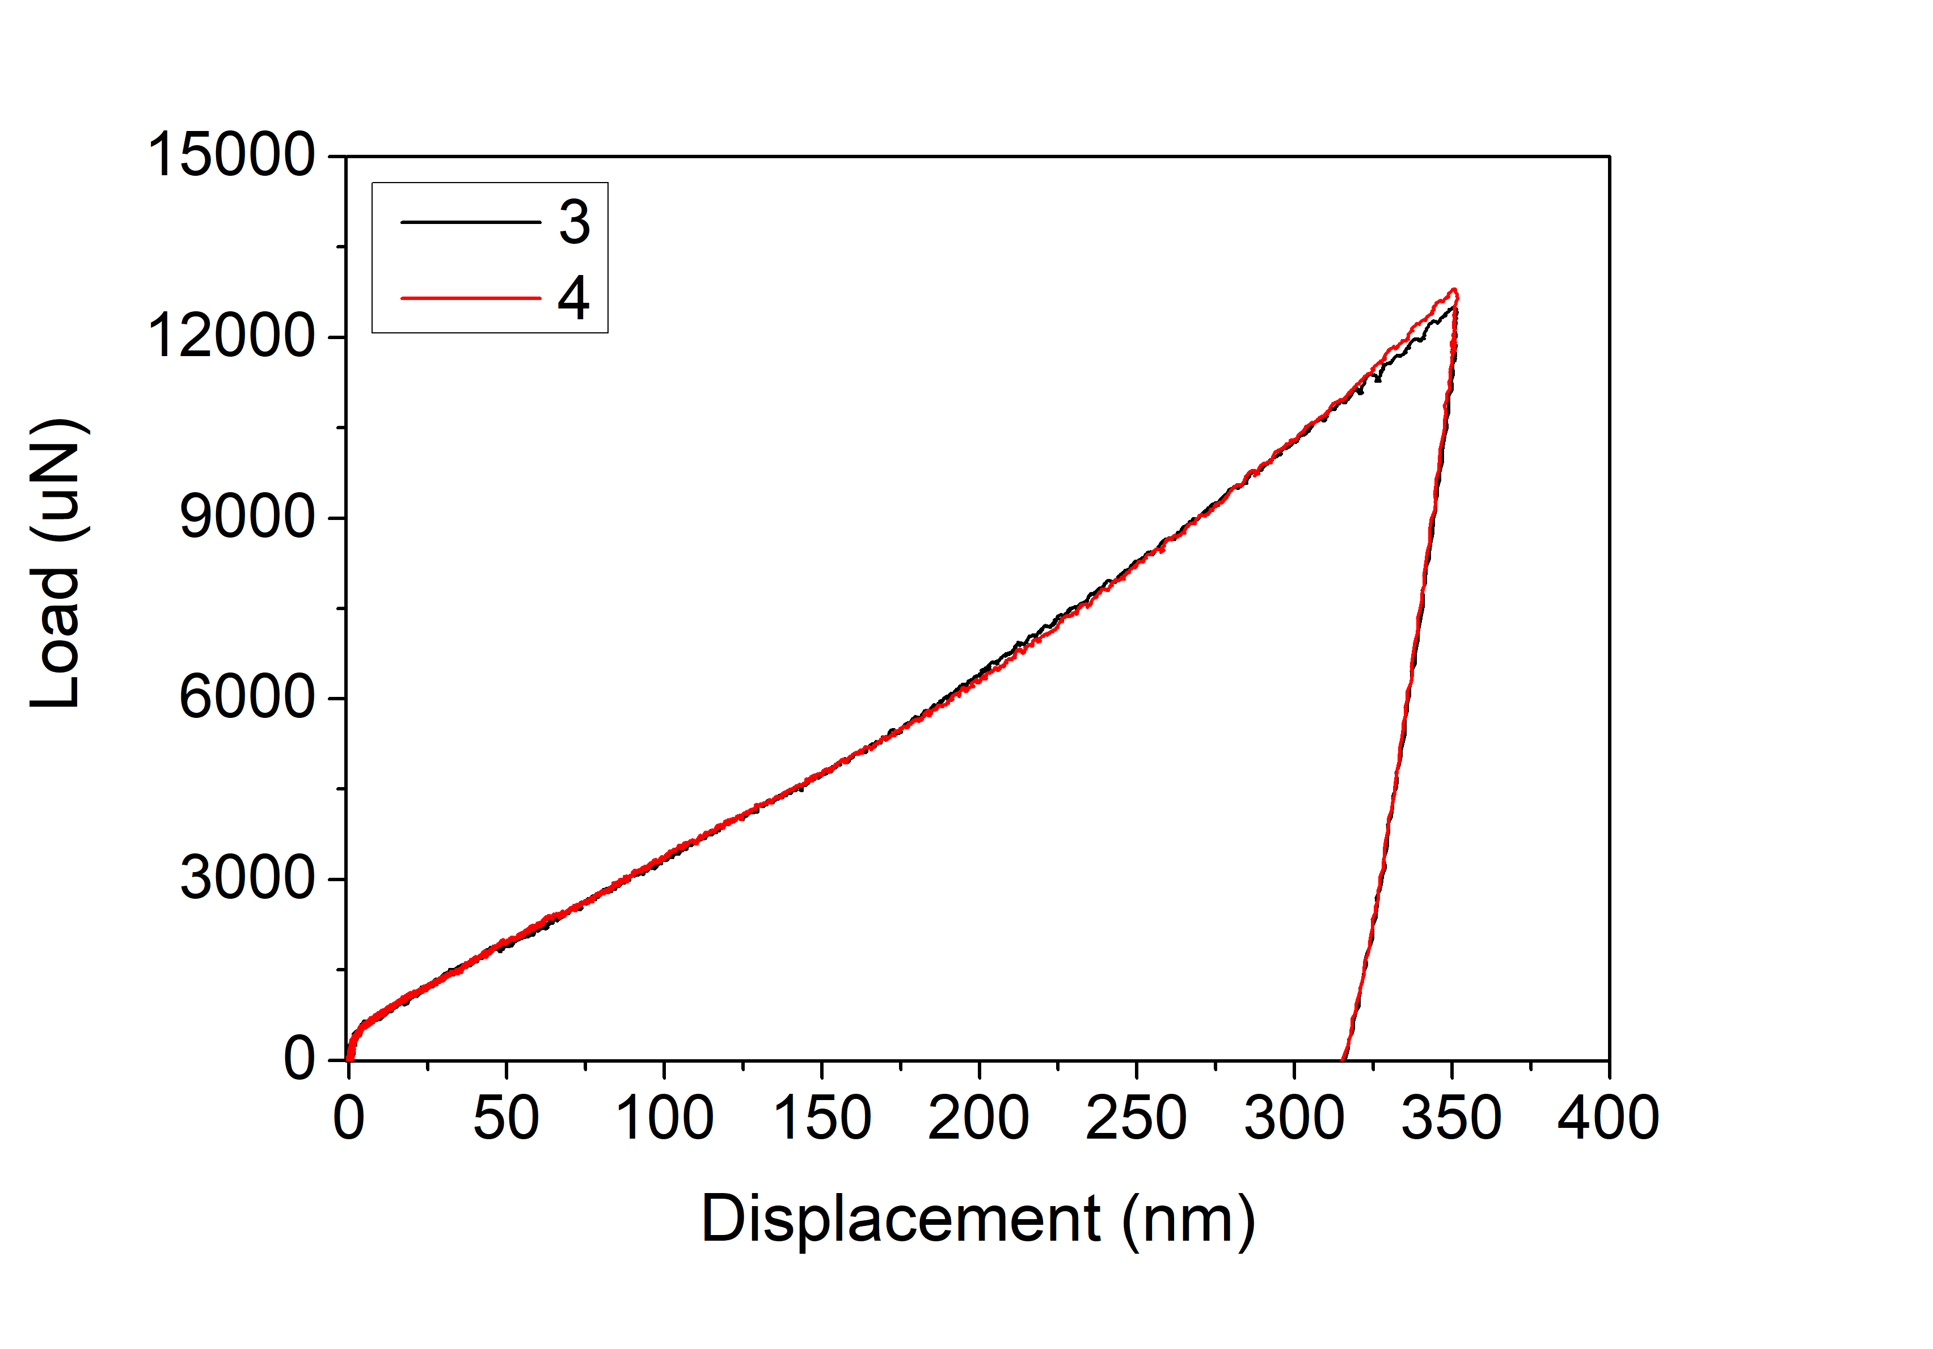
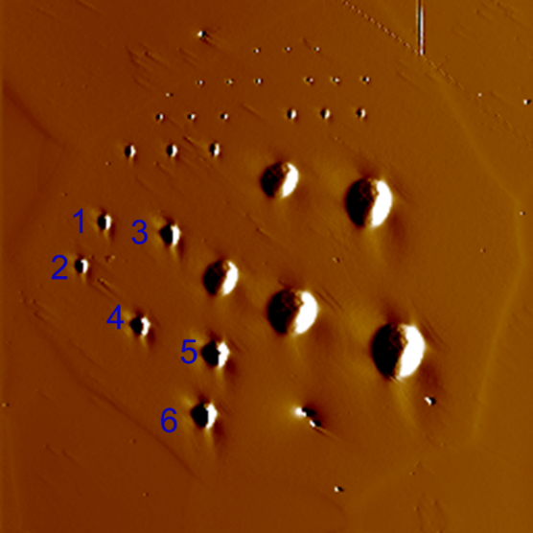
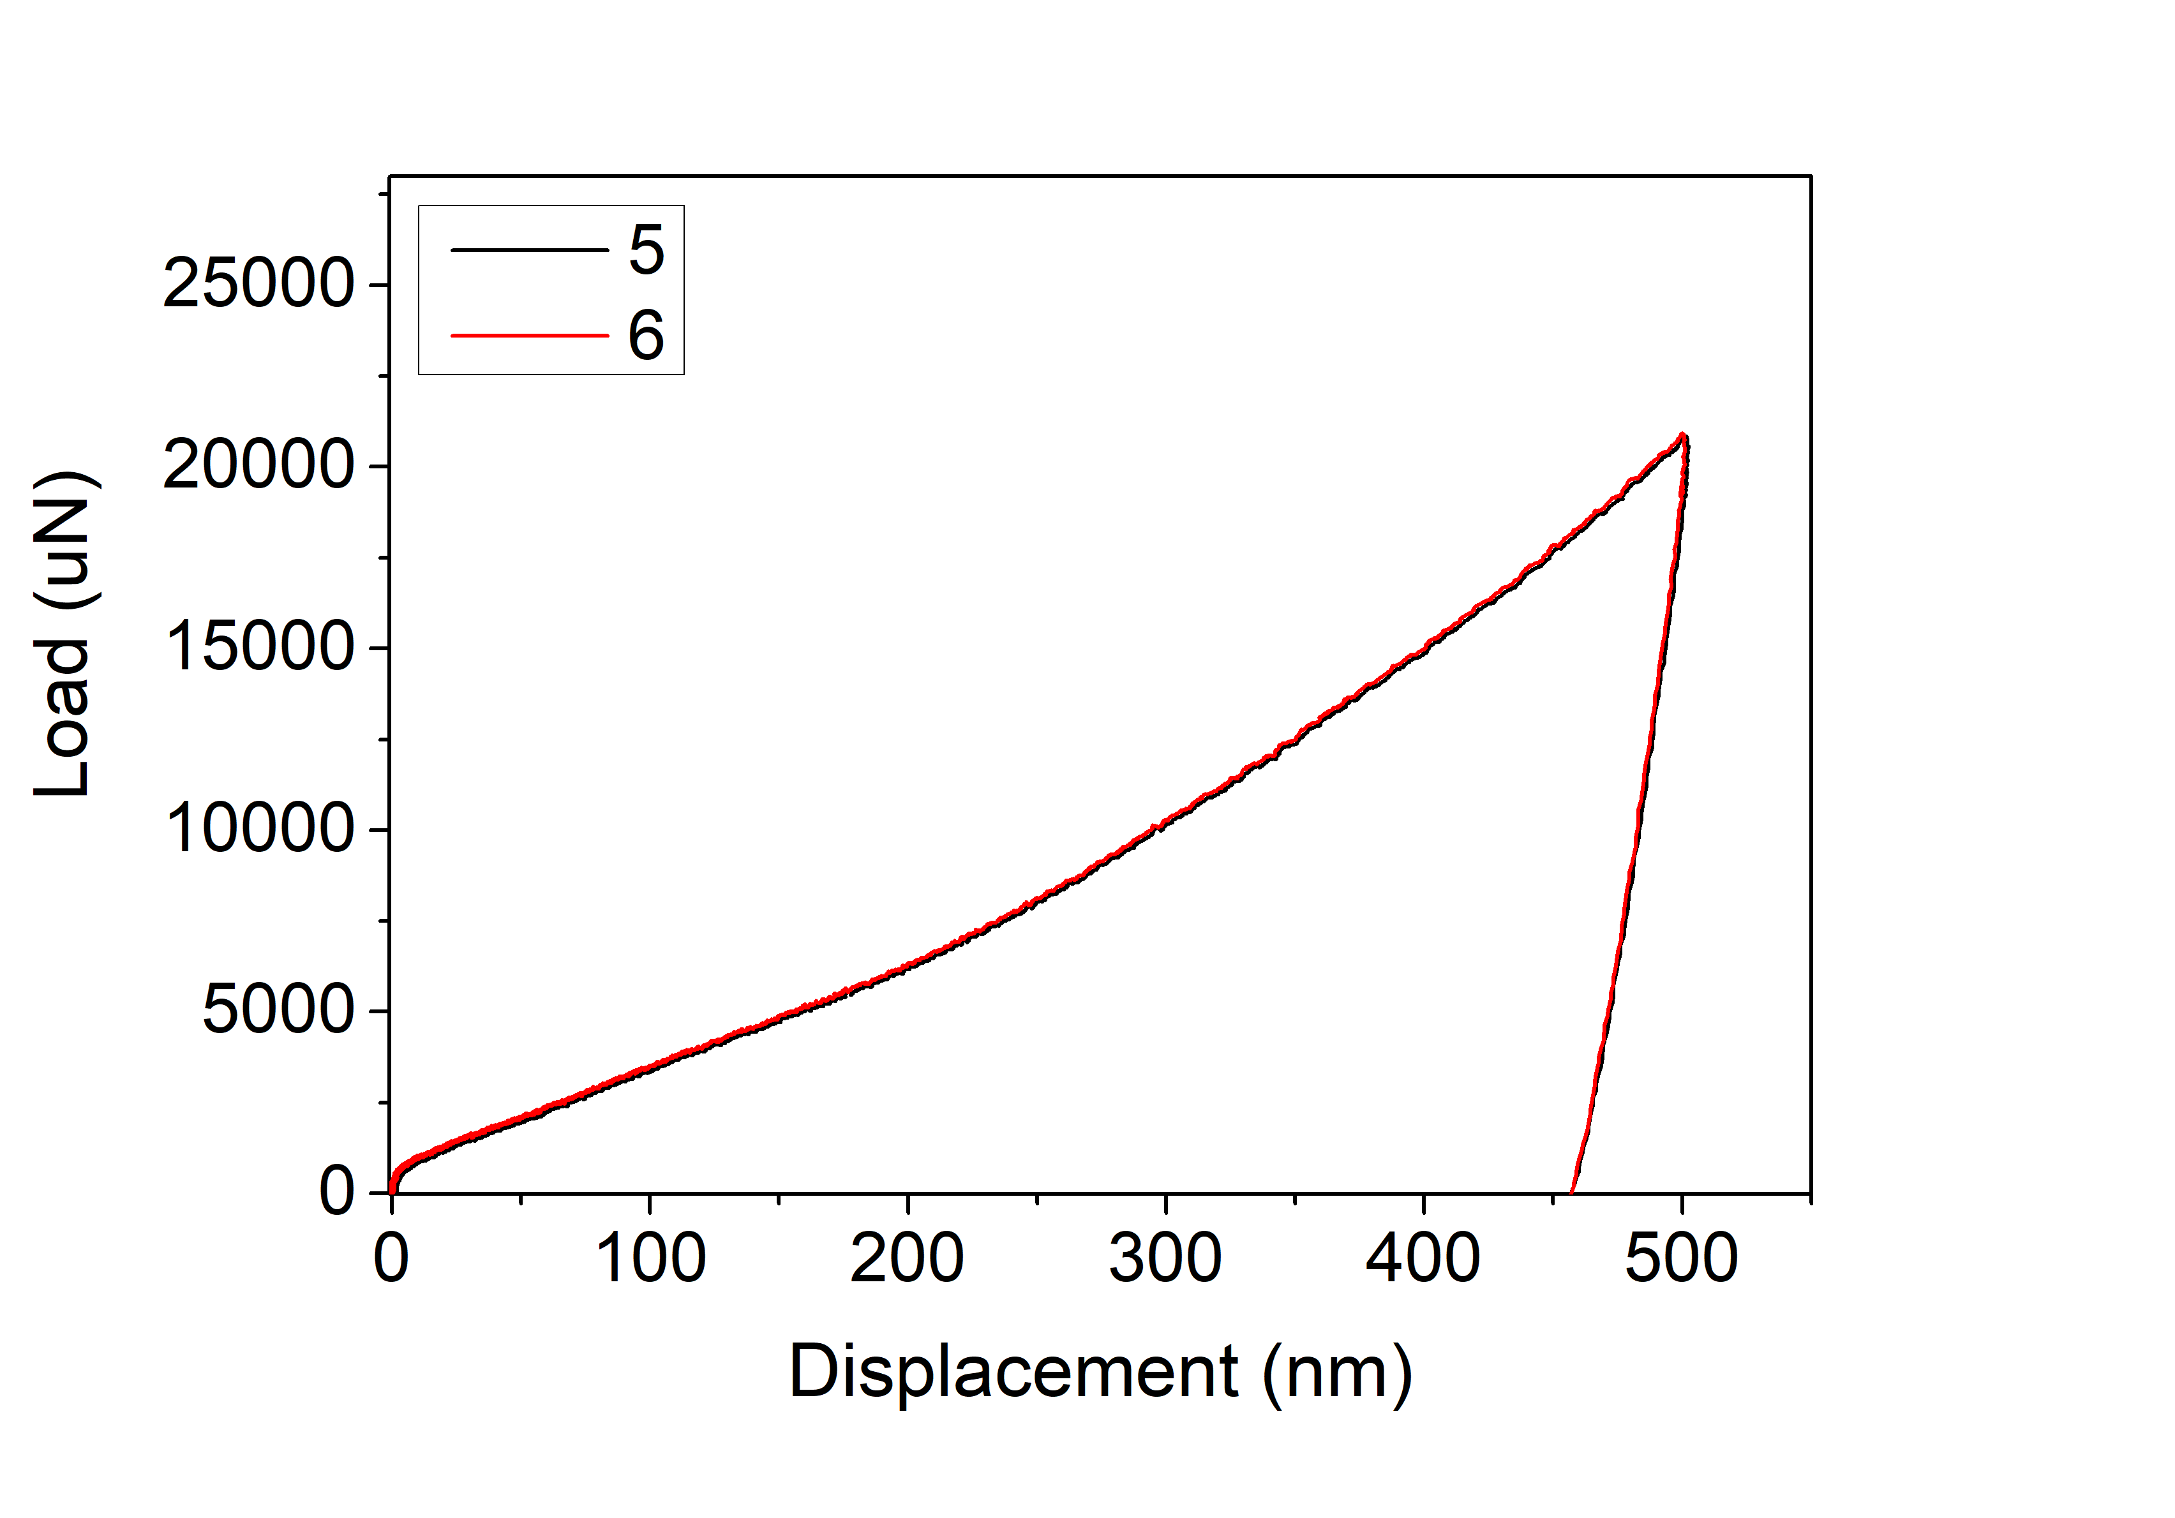
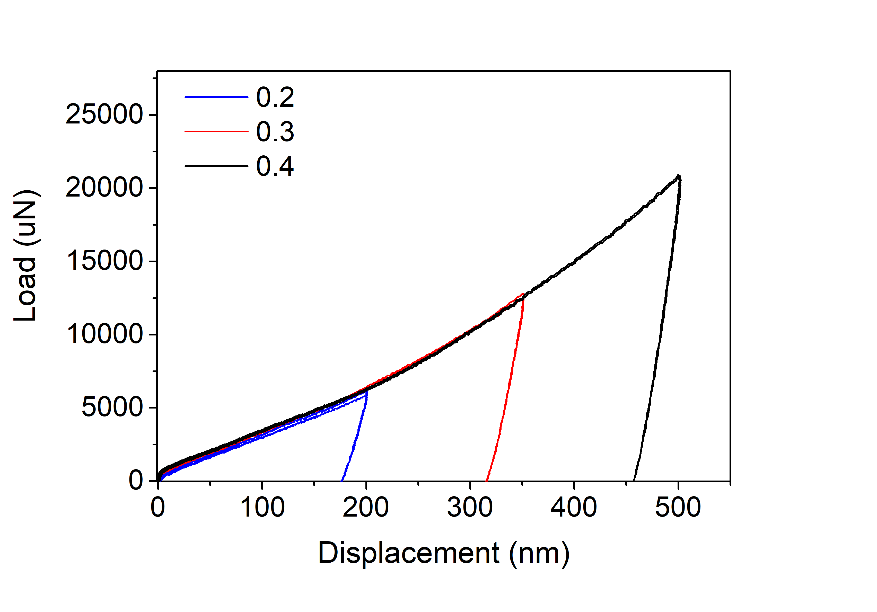
AISI439
Indenter radius 5um
1

Slide 7
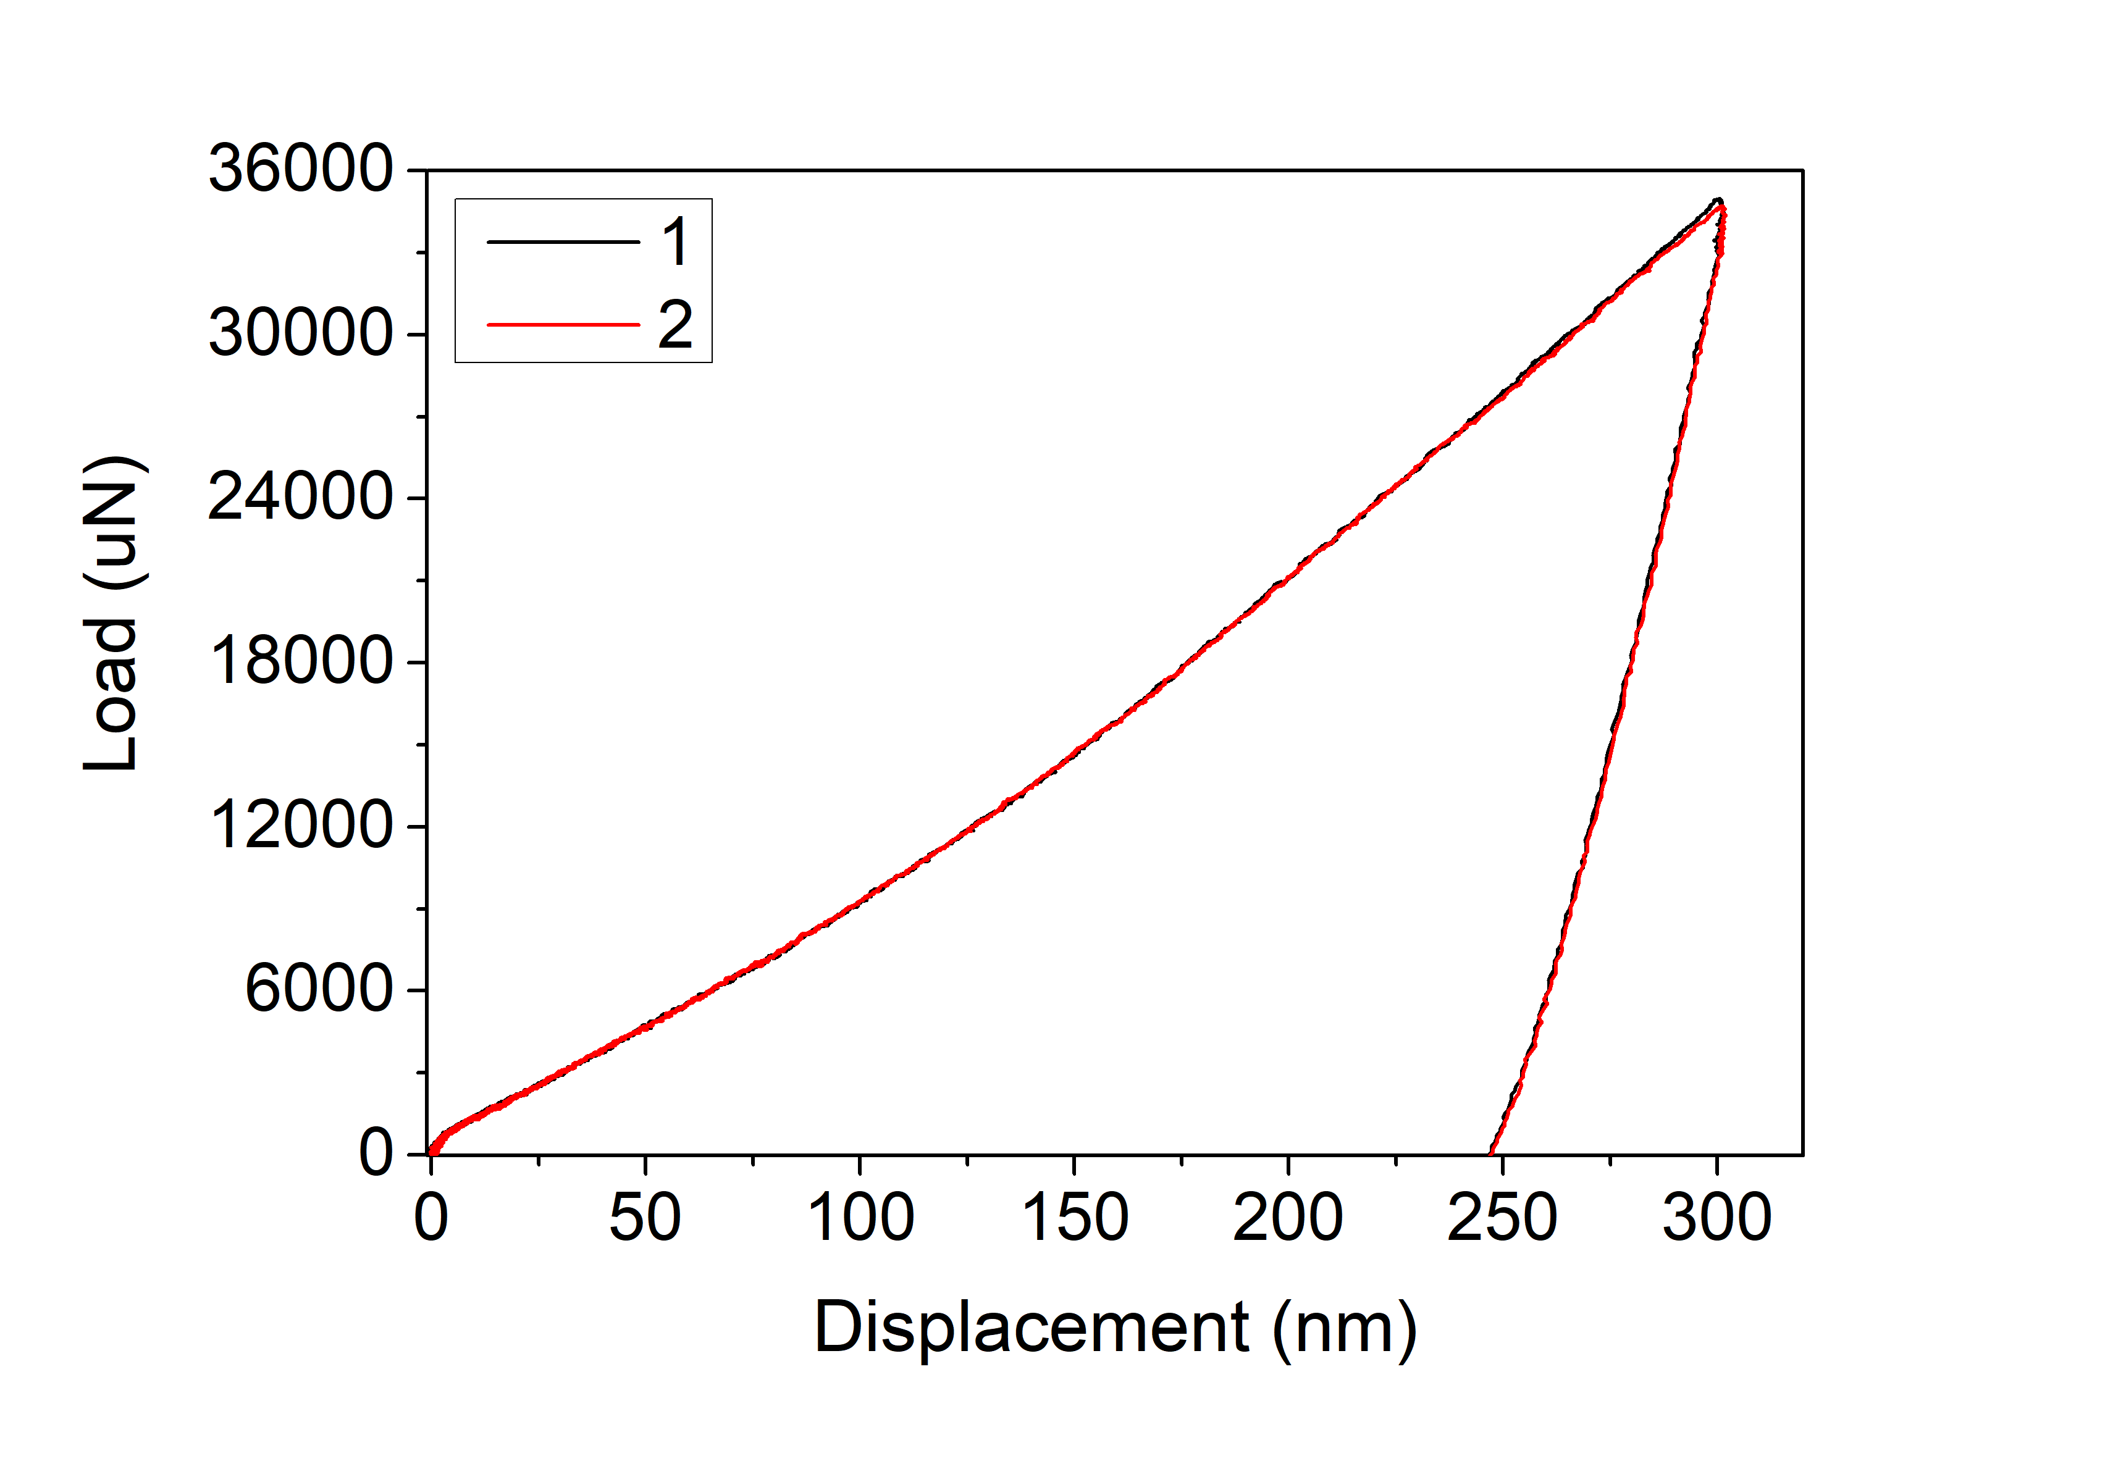
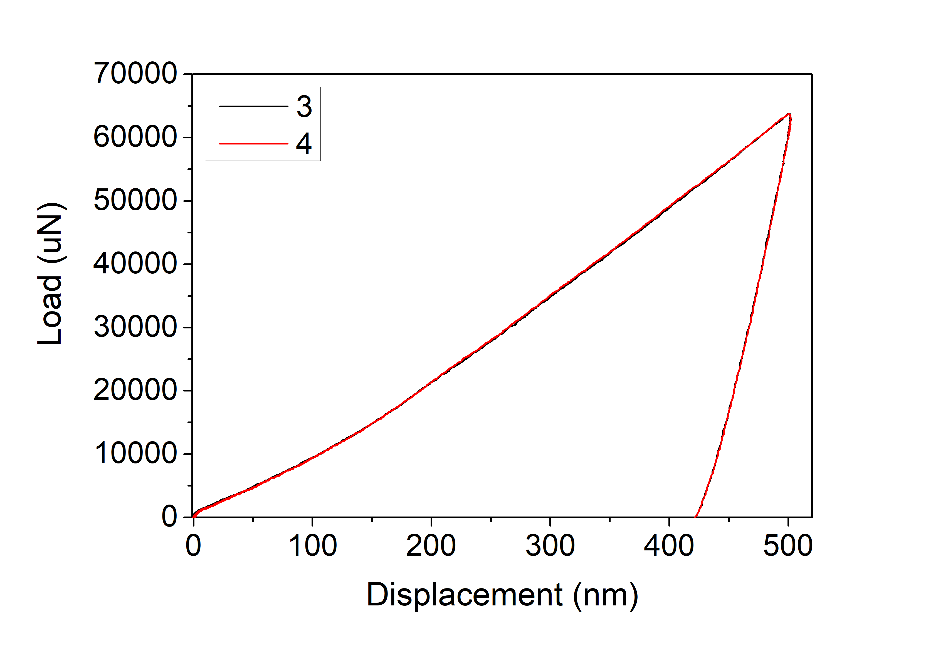
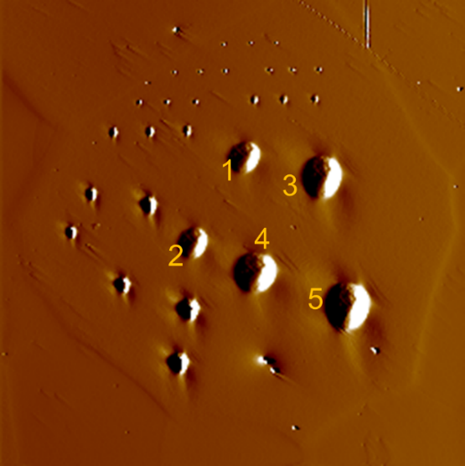
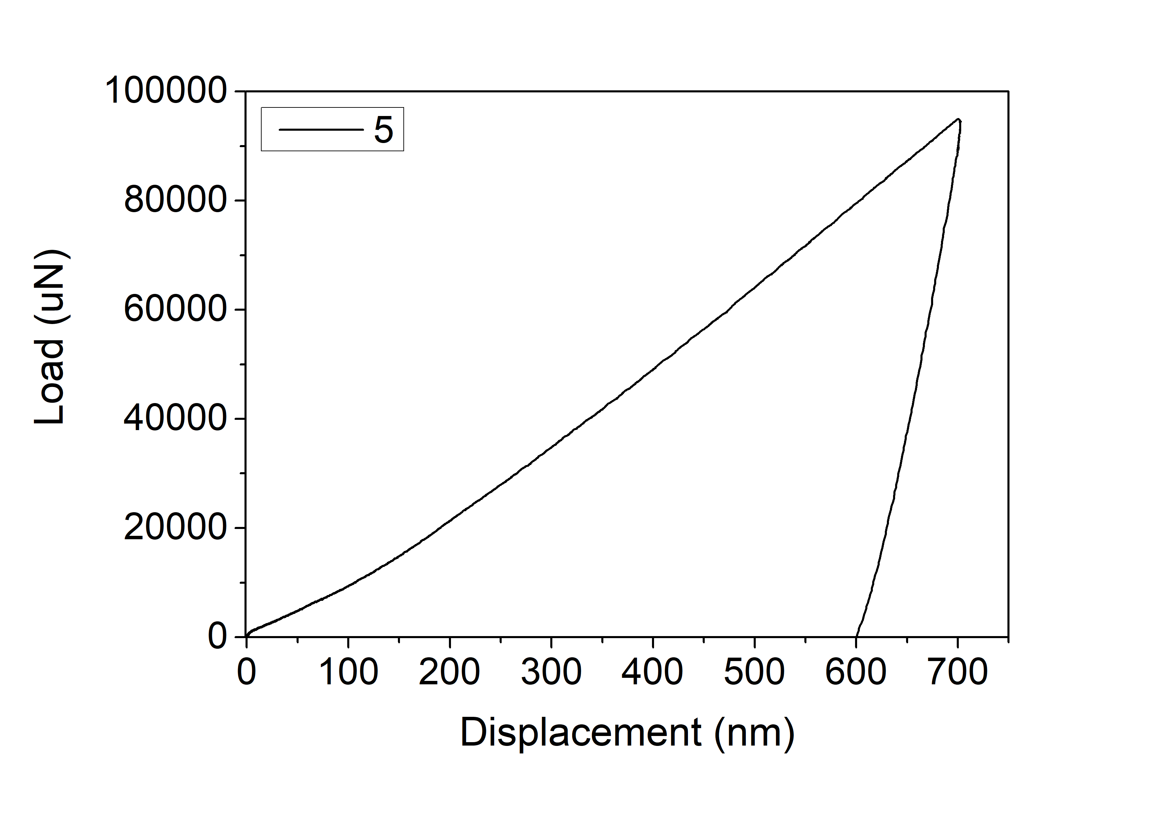
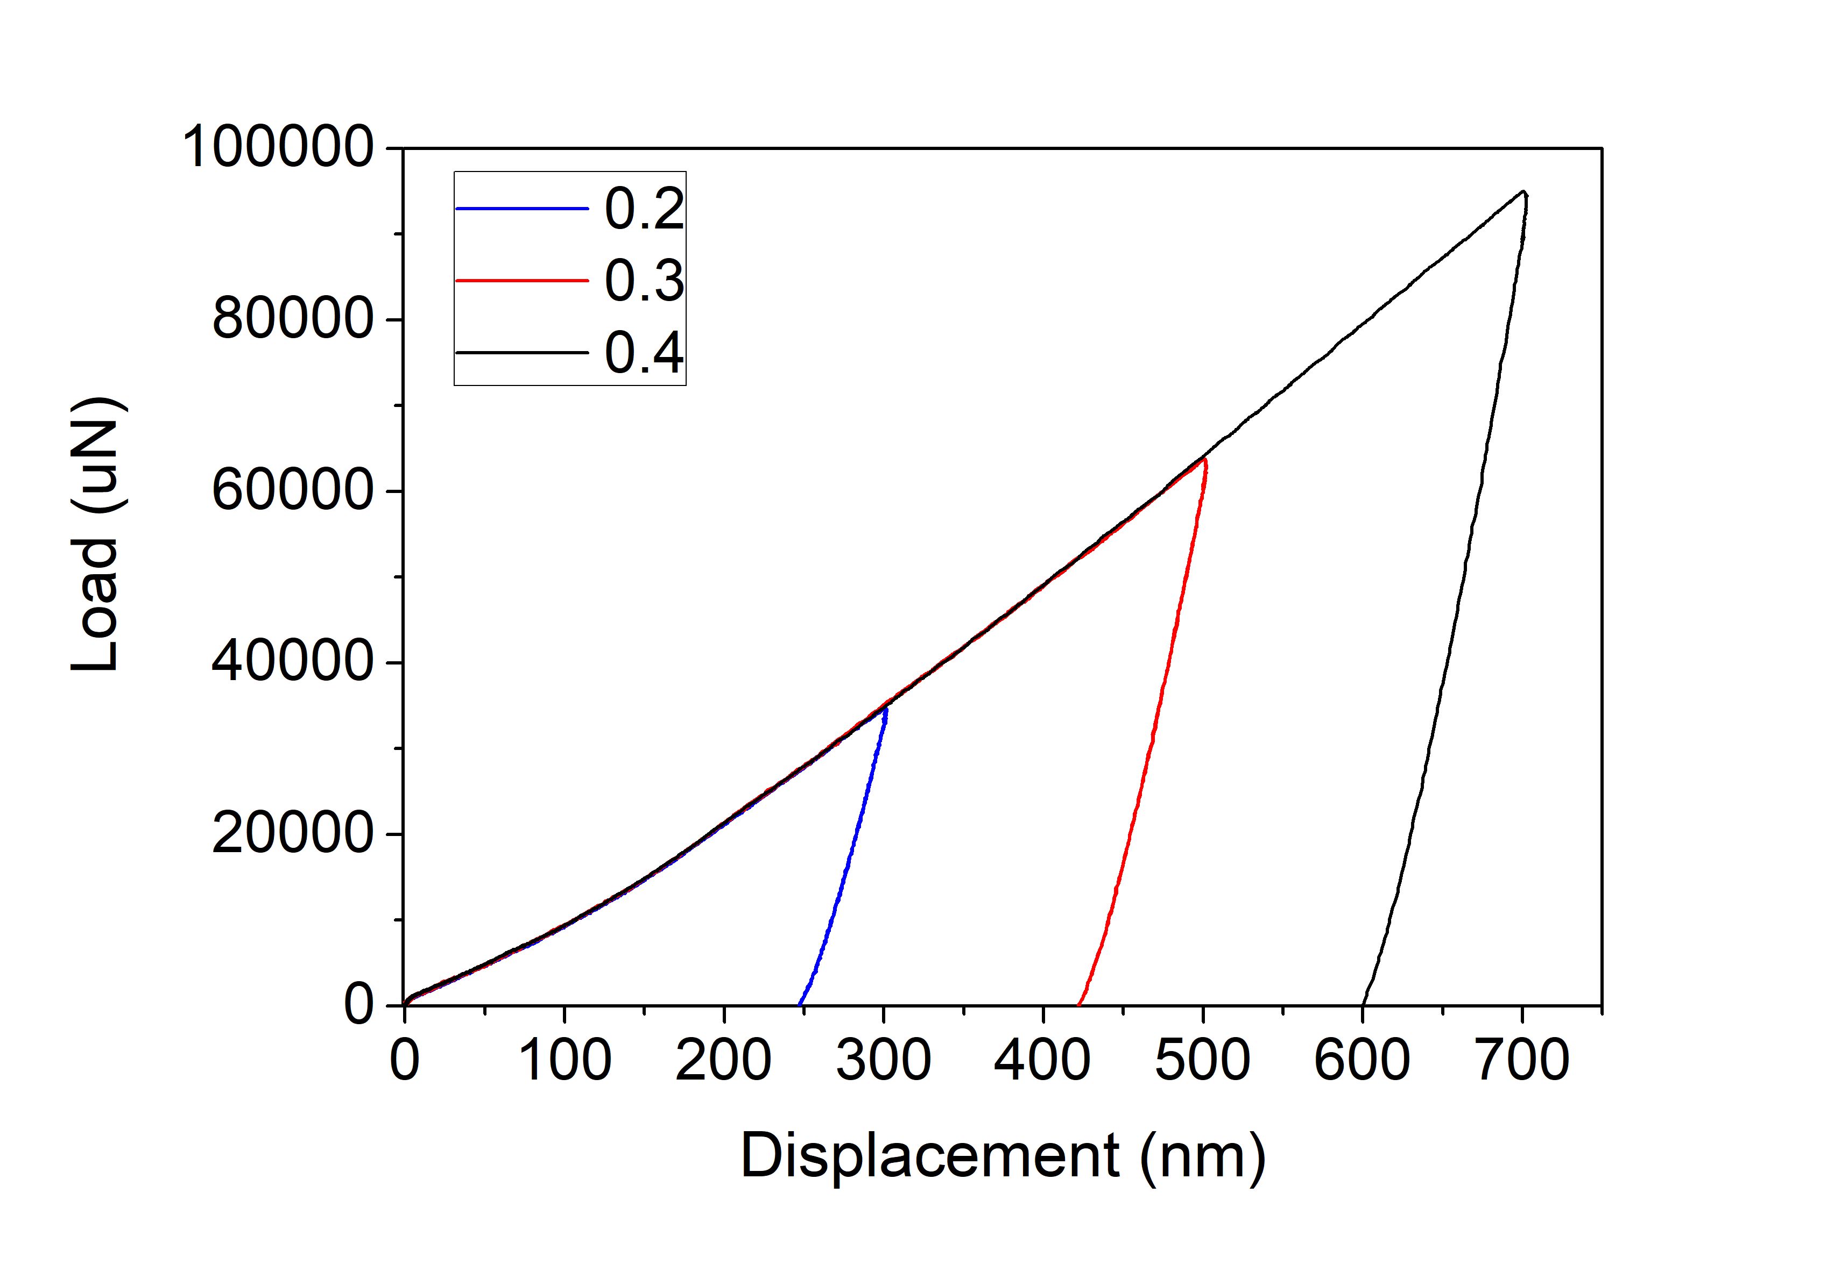
AISI439
Indenter radius 20um
1

Slide 8
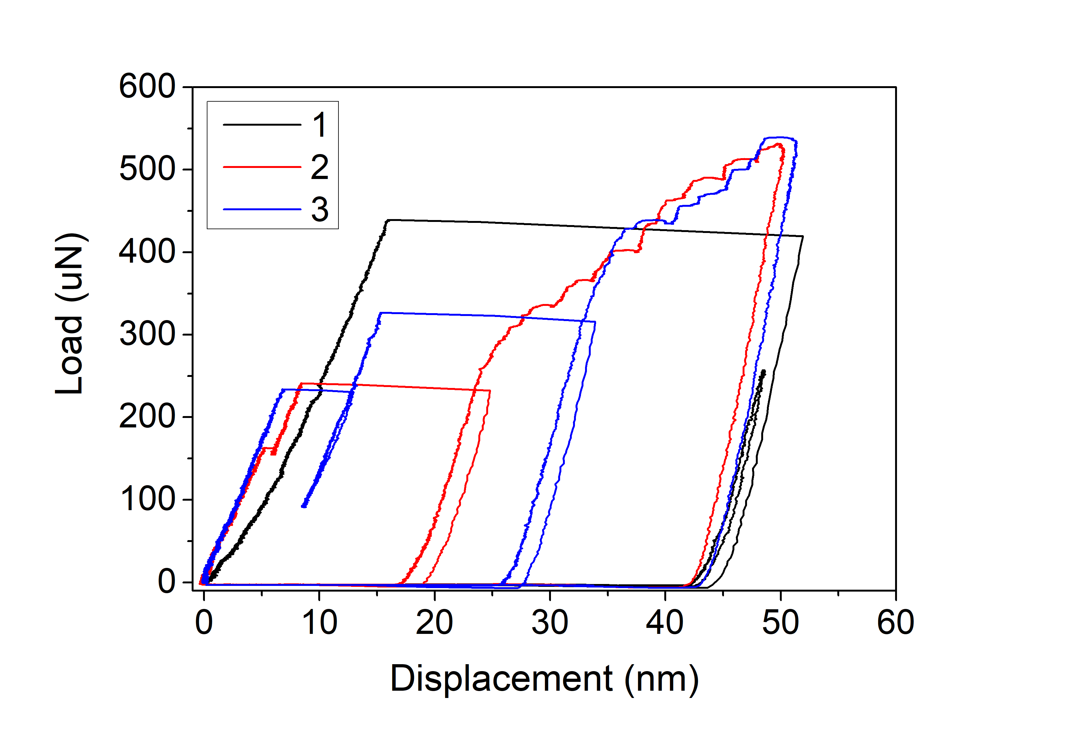
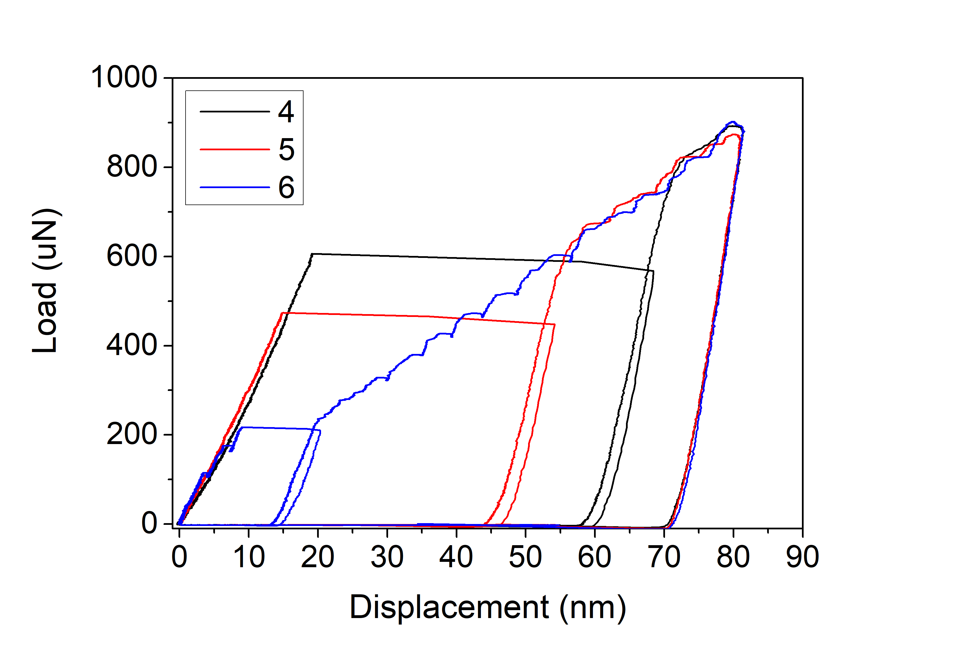
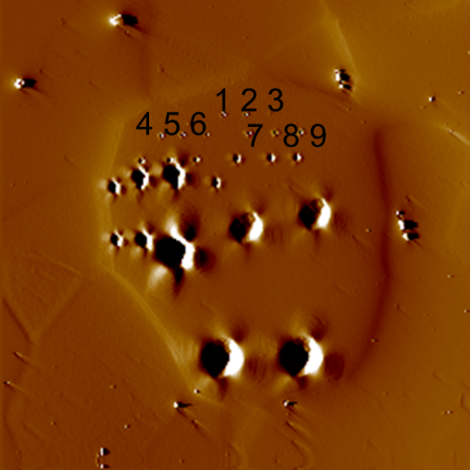
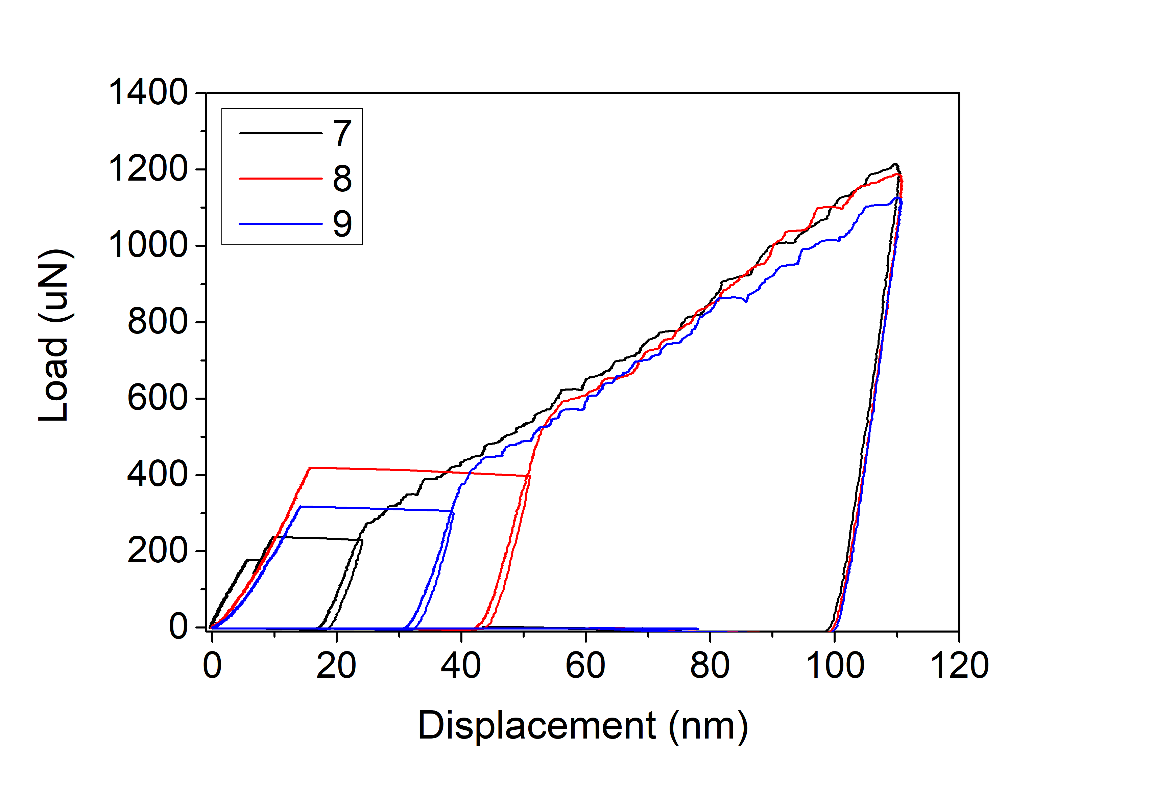
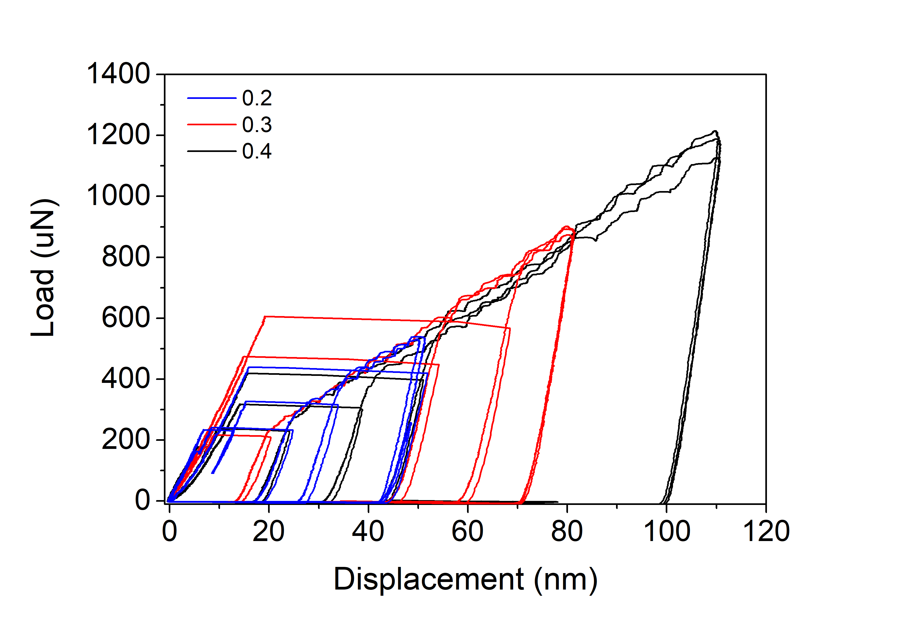
AISI439
Indenter radius 1um
1

Slide 9
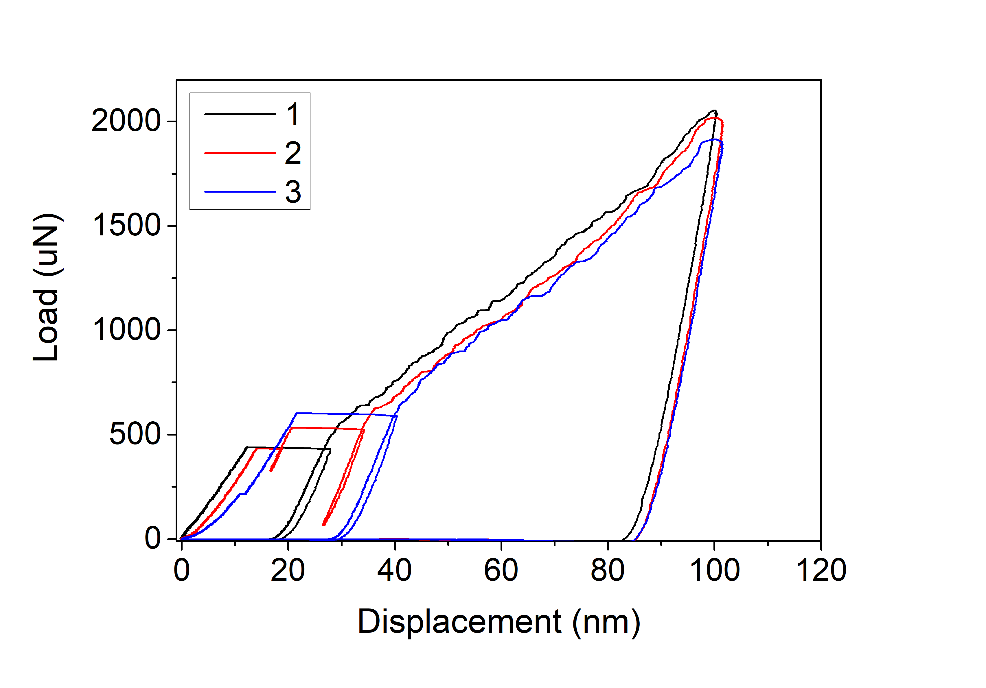
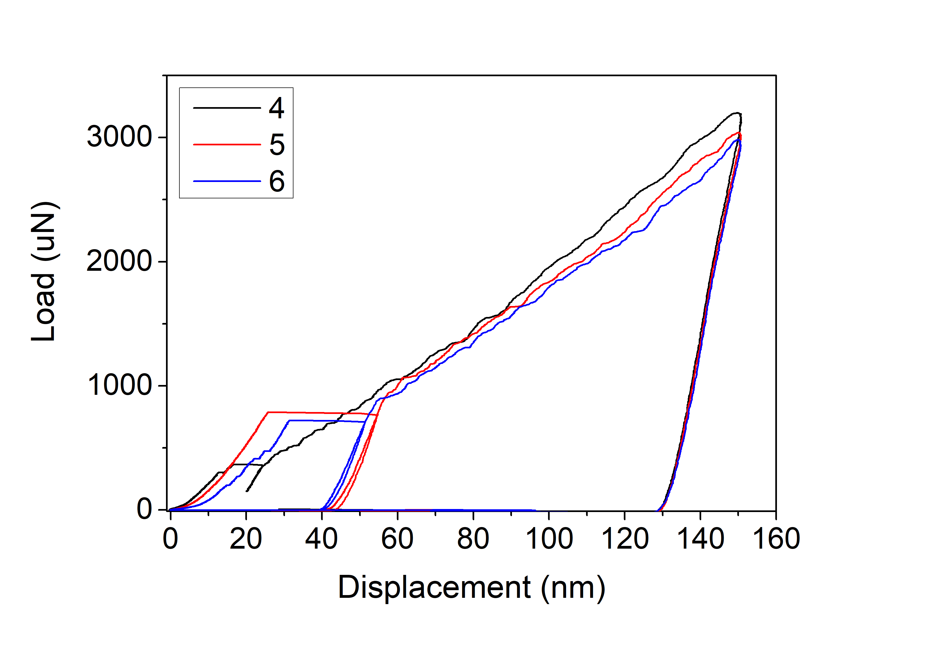
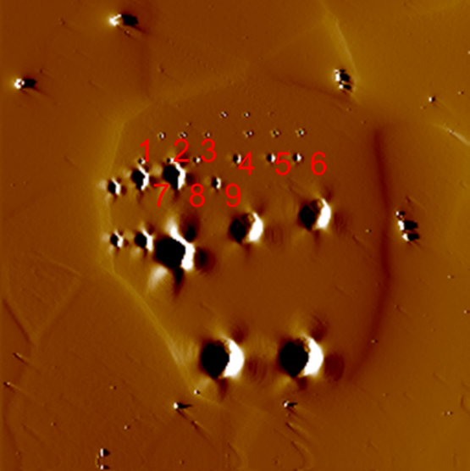
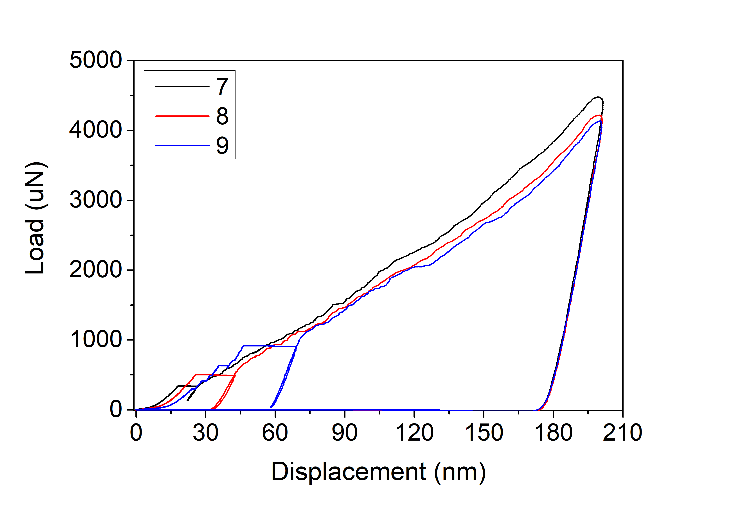
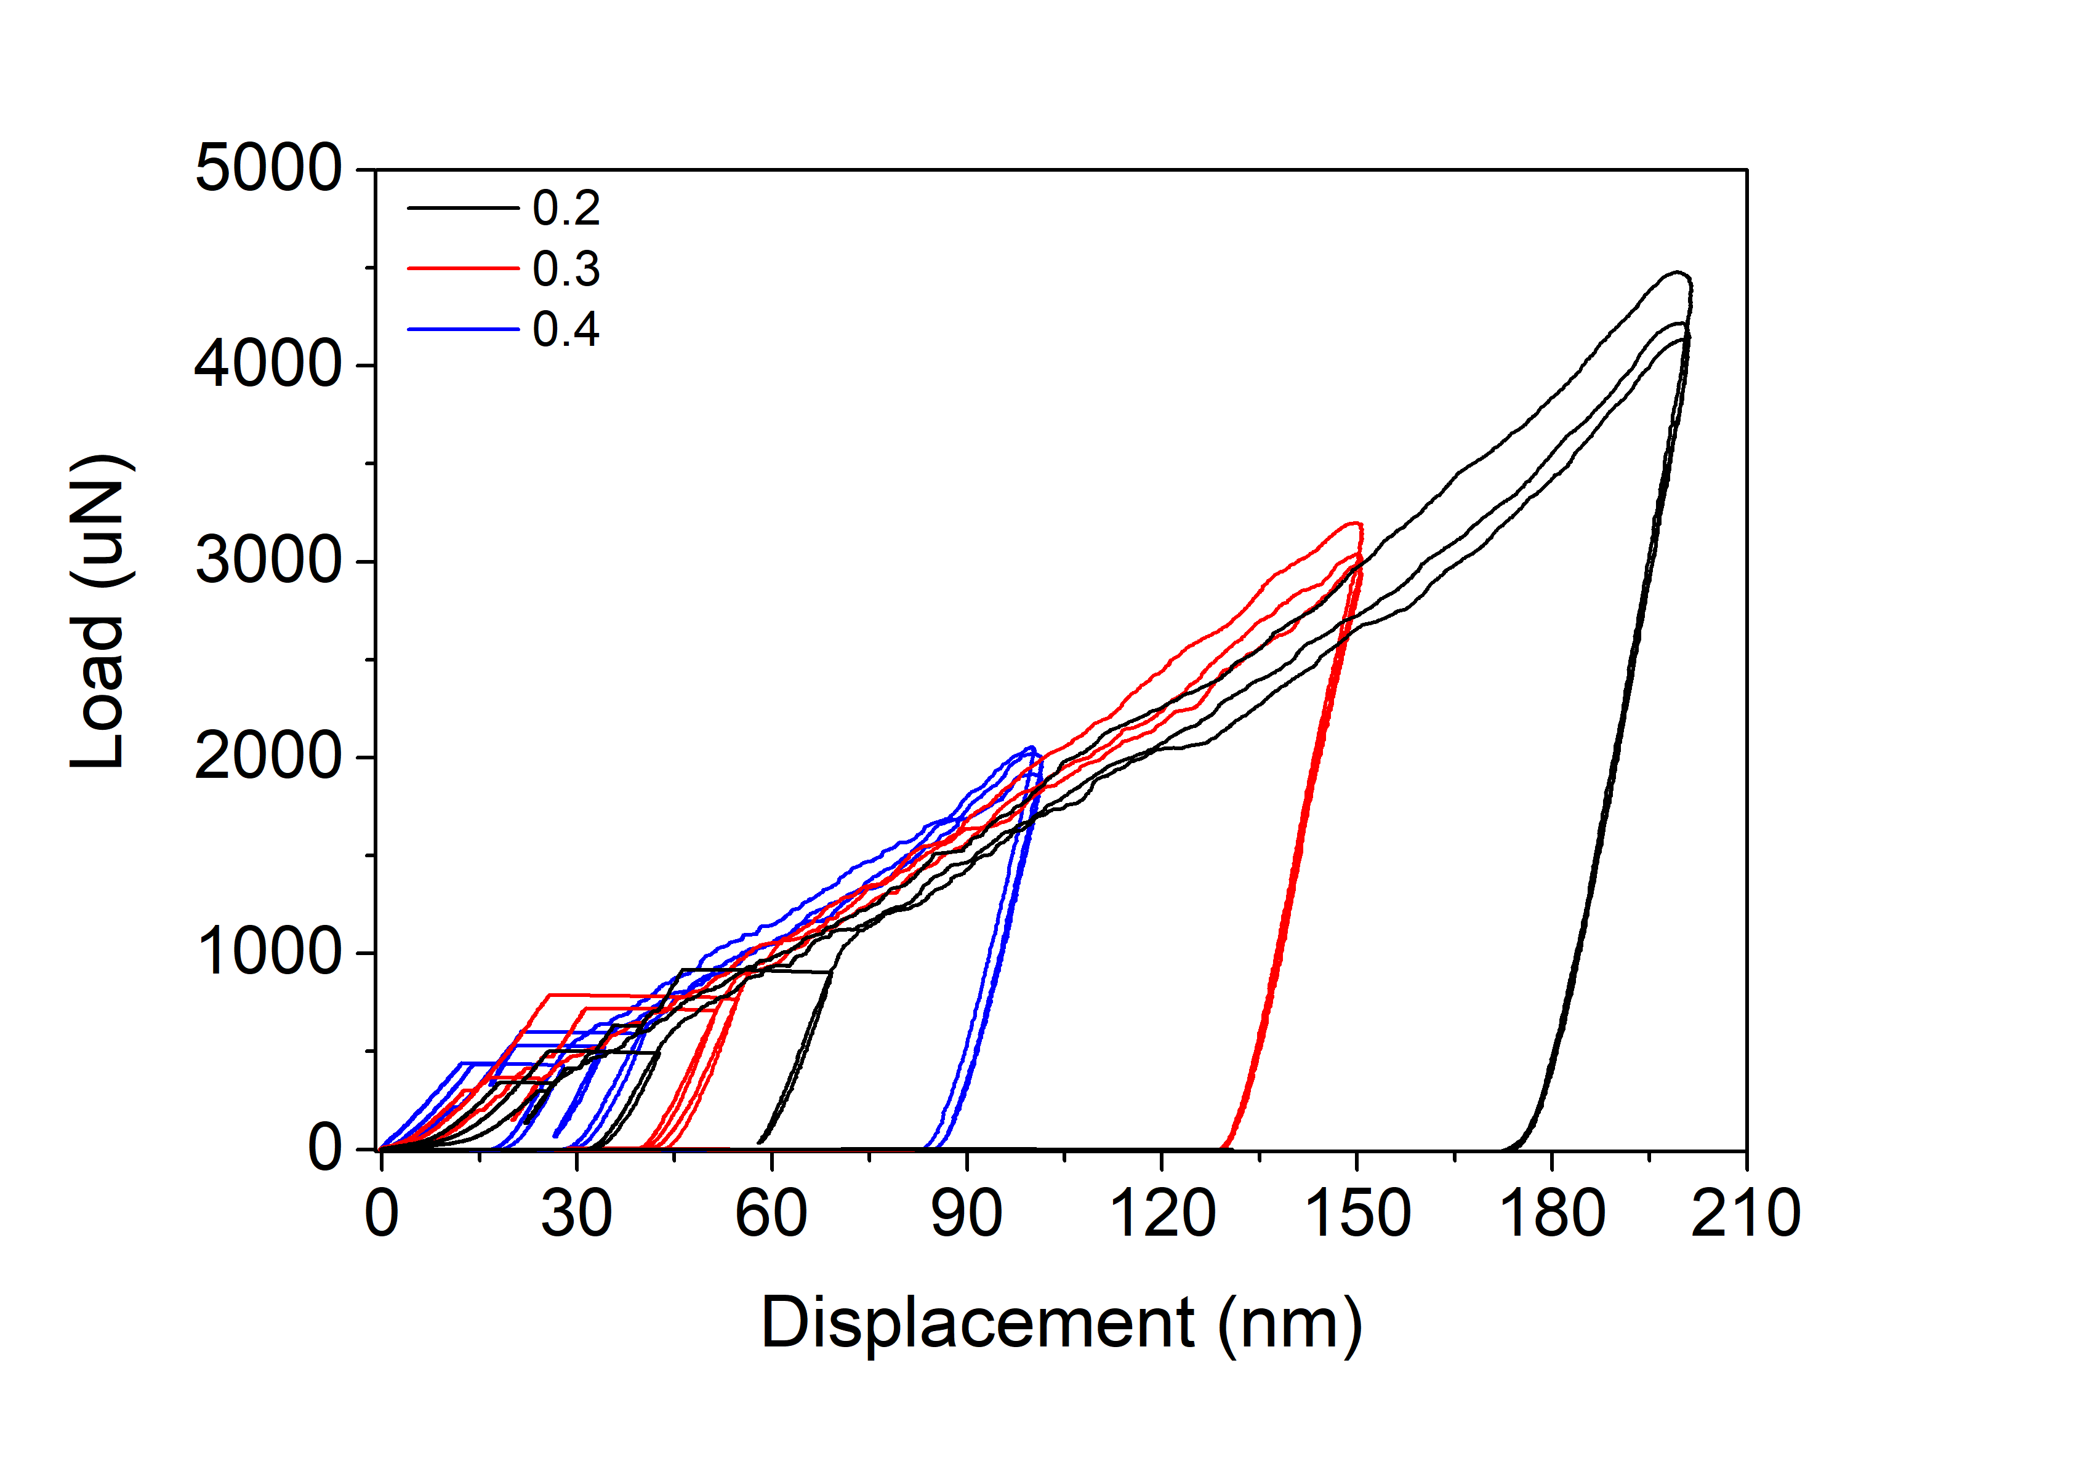
AISI439
Indenter radius 2um
1

Slide 10
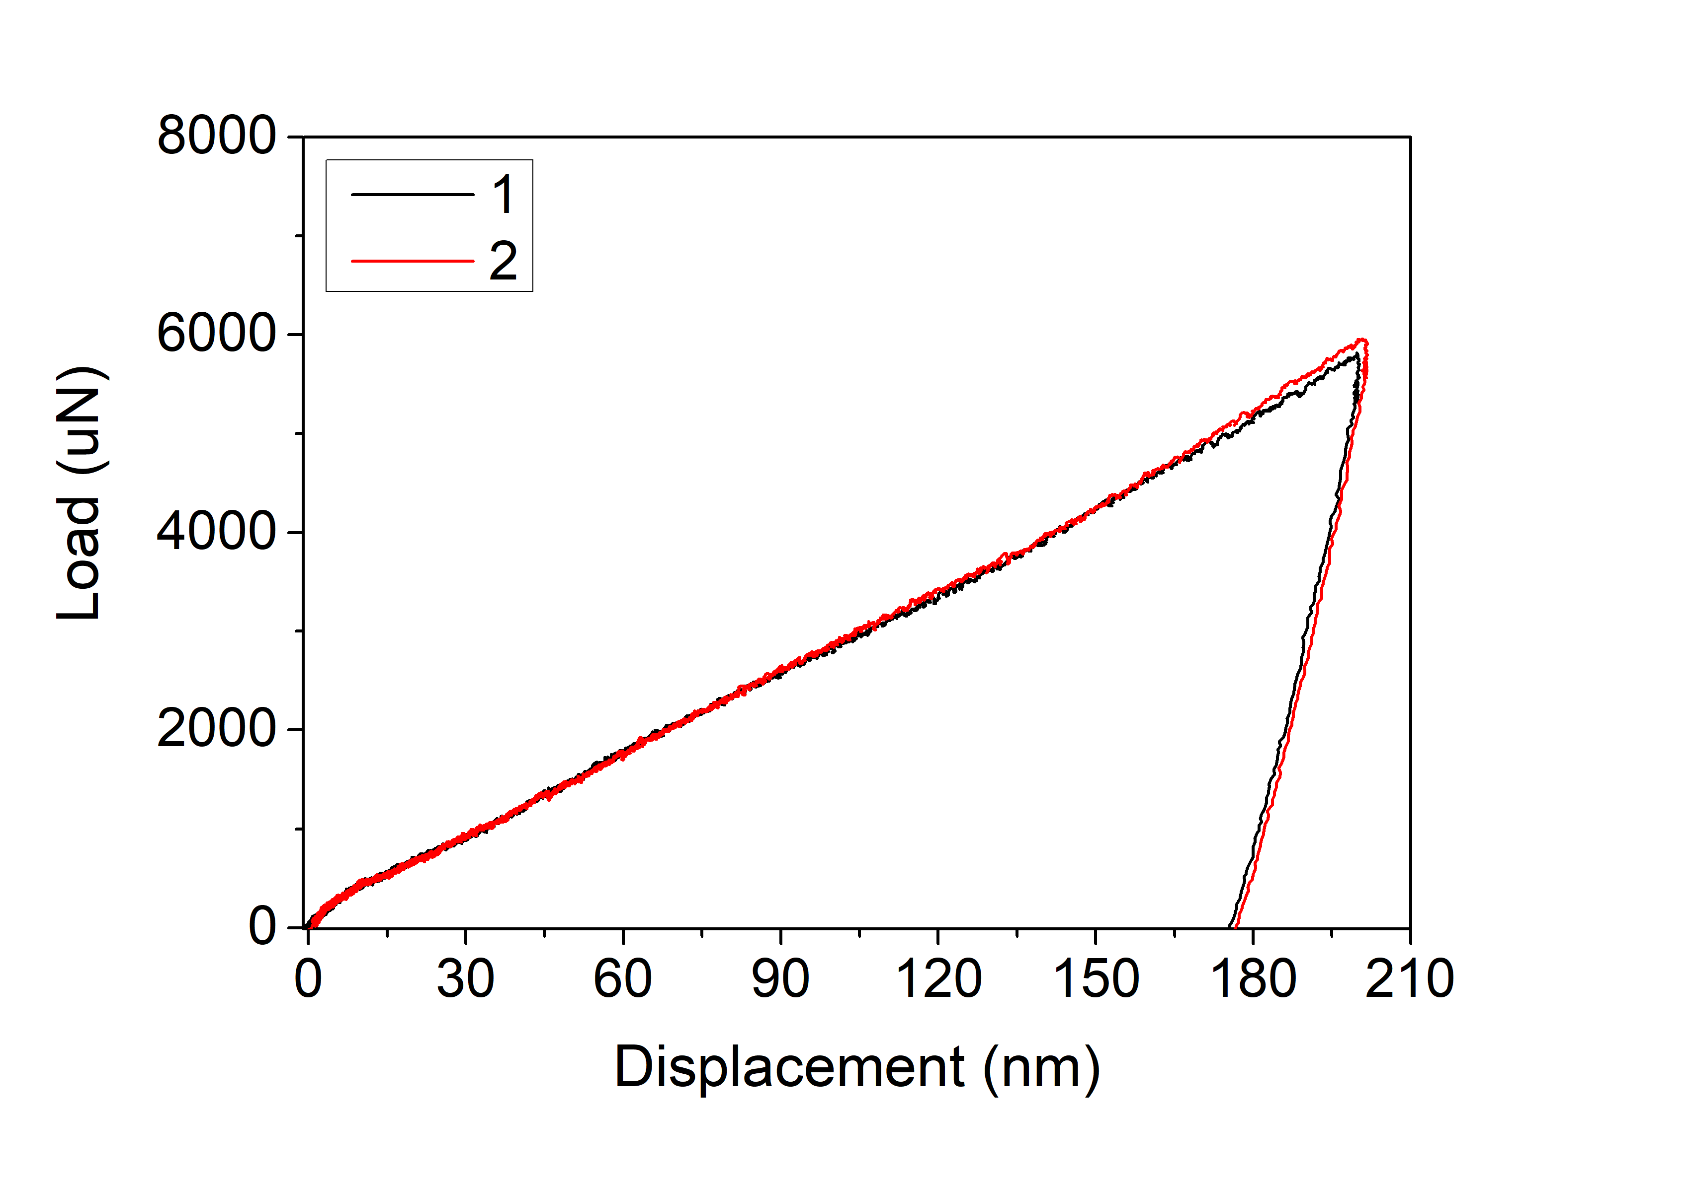
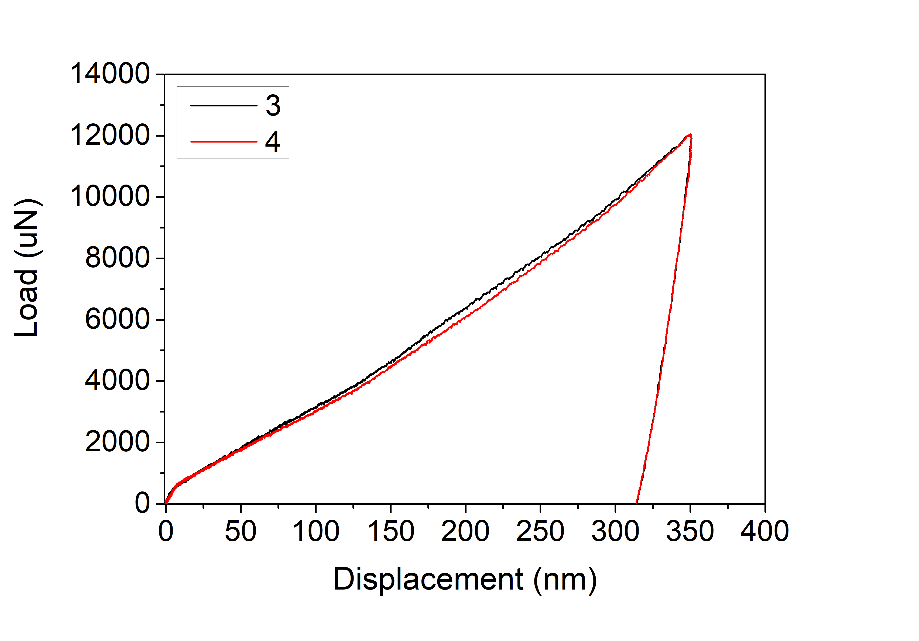
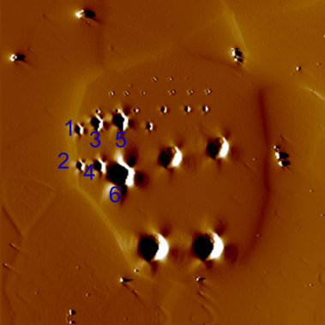
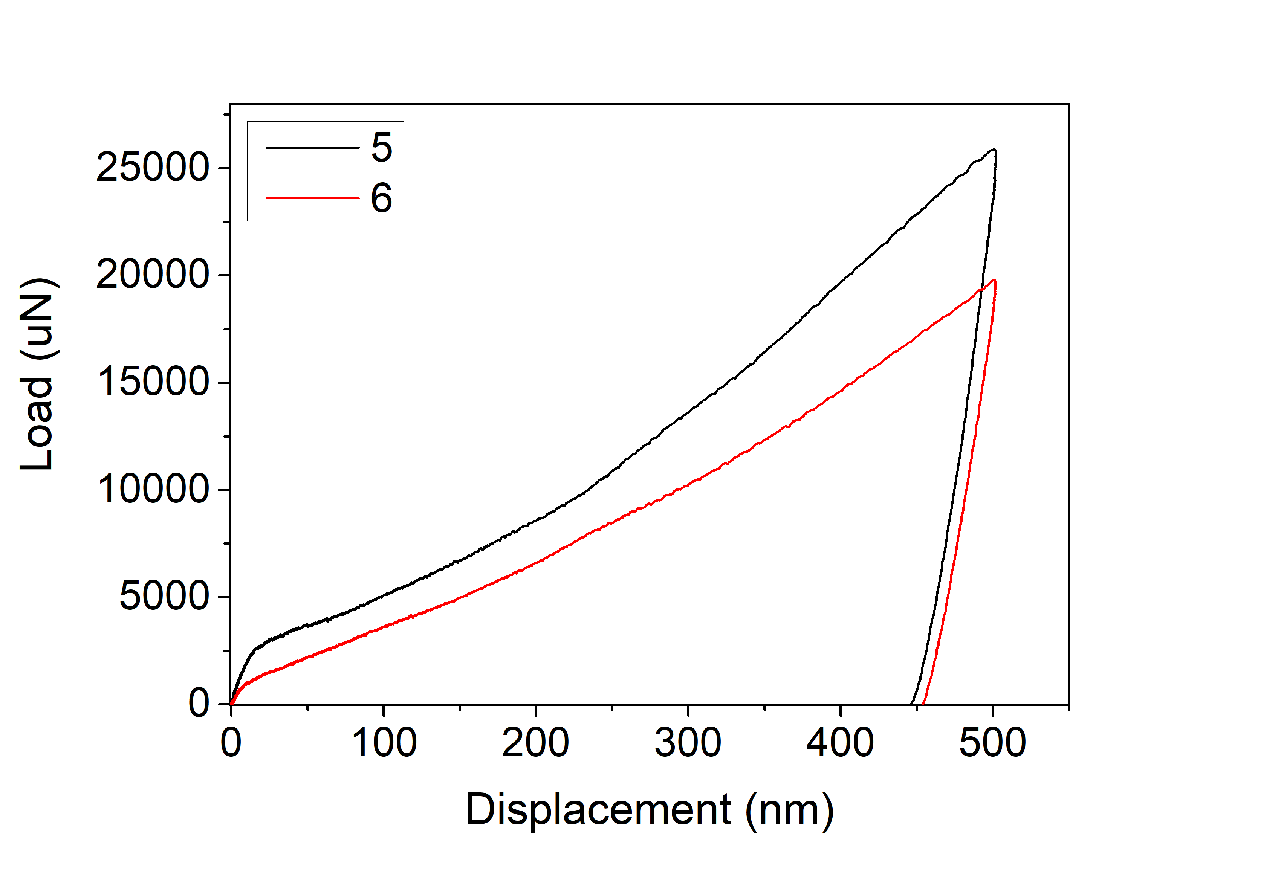
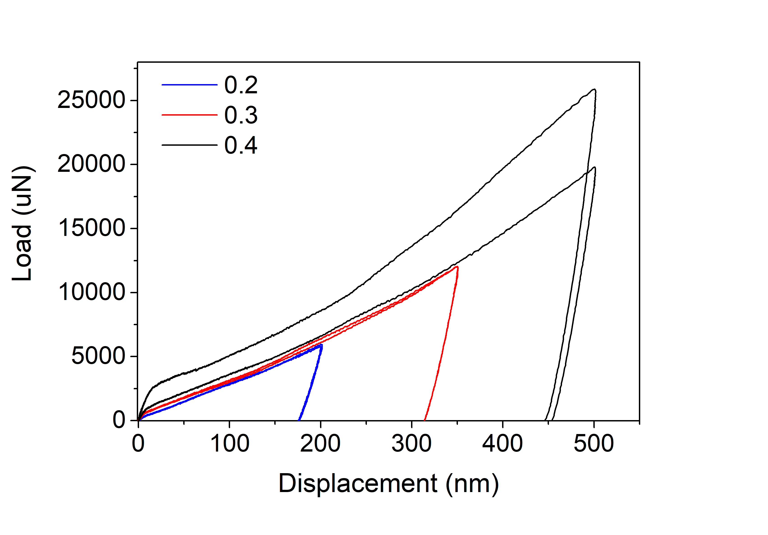
AISI439
Indenter radius 5um
1

Slide 11
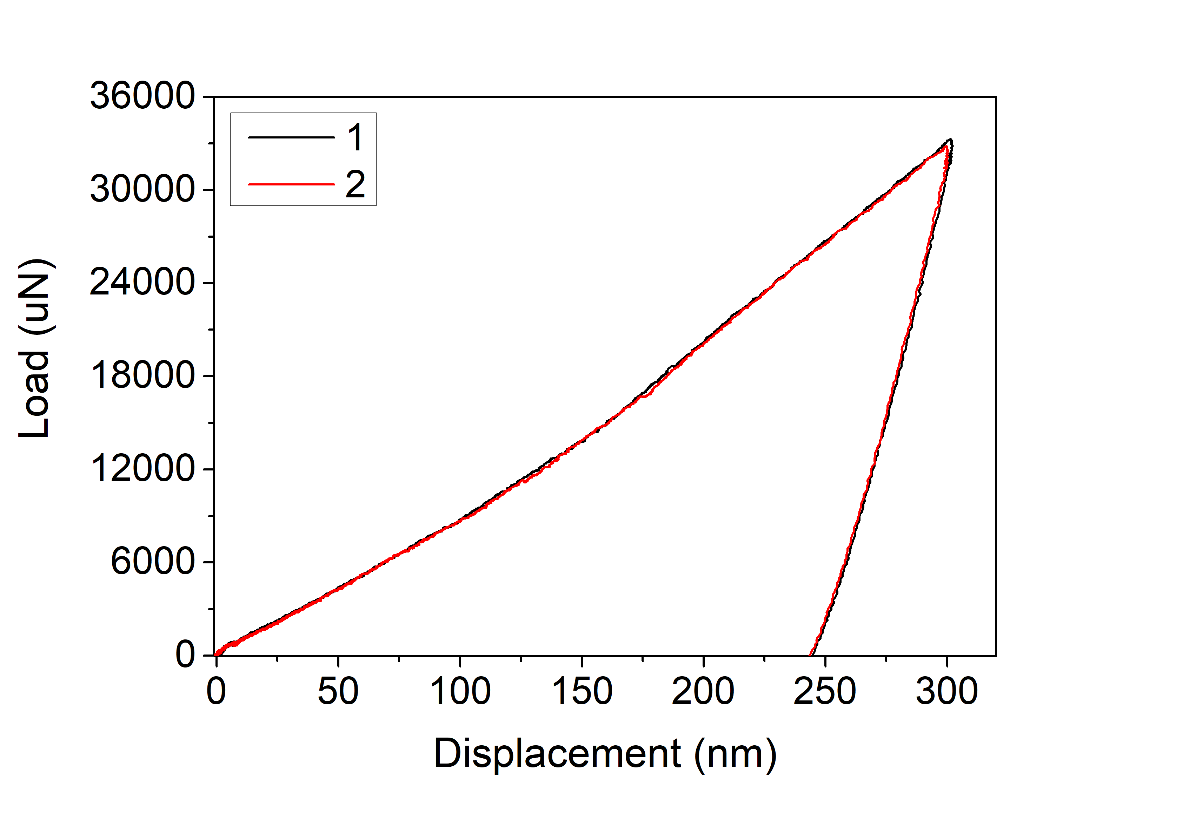
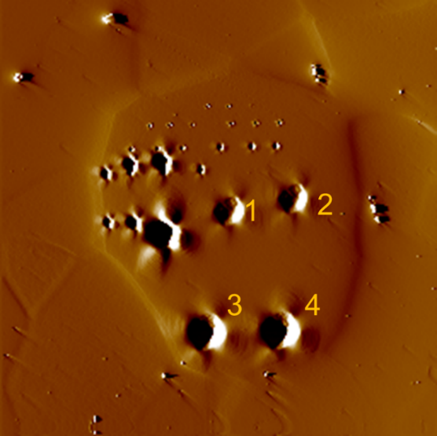
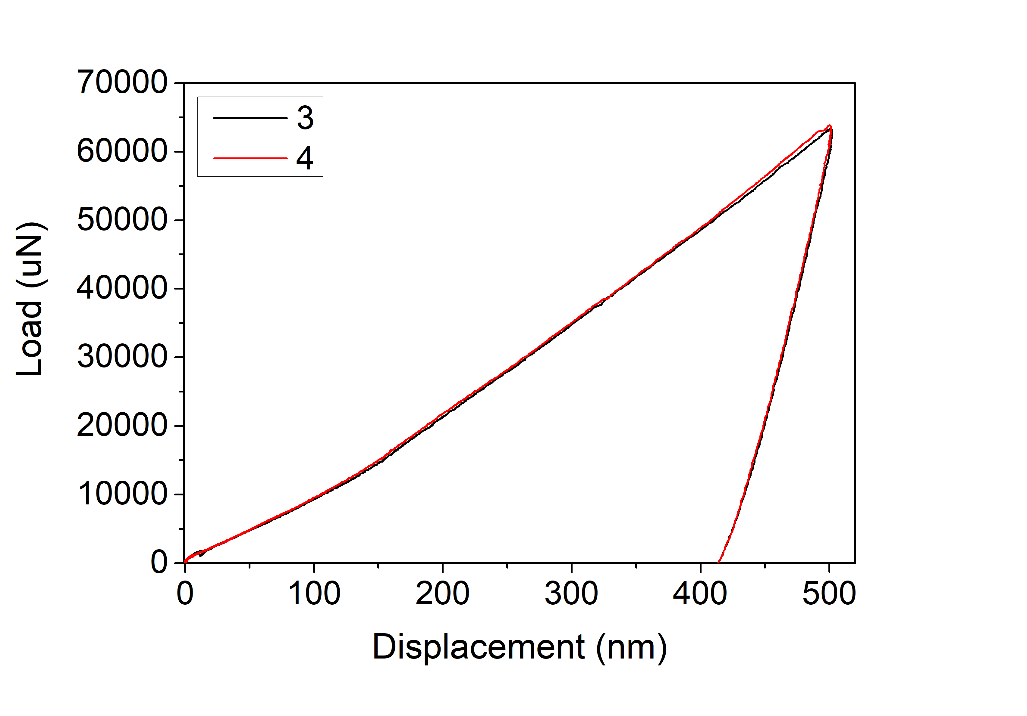
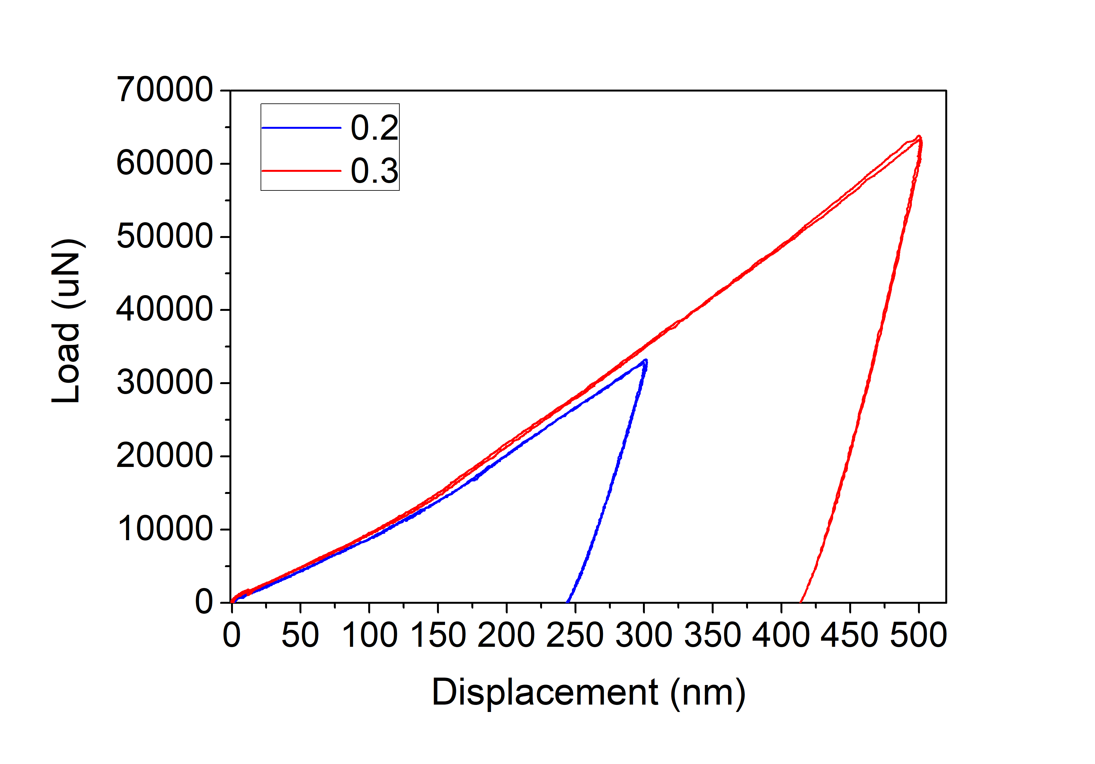
AISI439
Indenter radius 20um
1

Slide 12
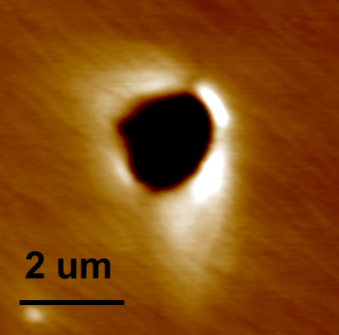

















AISI439-Grain 4833-1um
0.2
0.3
0.4
1

Slide 13
AISI439-Grain 4833-2um
0.2
0.3
0.4
1

Slide 14









AISI439-Grain 4833-5um
0.2
0.3
0.4
1

Slide 15









AISI439-Grain 4833-20um
0.2
0.3
0.4
1

Slide 16









AISI439-Grain 4200-1um
0.2
0.3
0.4
1

Slide 17









AISI439-Grain 4200-2um
0.2
0.3
0.4
1

Slide 18






AISI439-Grain 4200-5&20um
5um0.2
20um
0.3
1

Slide 19
AISI439
Hardness
1

Slide 20
AISI439
Hardness
Grain 4833
1

Slide 21
AISI439
Hardness
Grain 4200
1

Slide 22






AISI439_grain4833
0.2
0.3
0.4
1 um
2 um
1

Slide 23






AISI439_grain4833
0.2
0.3
0.4
5 um
20 um
1

Slide 24






AISI439_grain4833_1um
0.2
0.3
0.4
1

Slide 25






AISI439_grain4833_2um
0.2
0.3
0.4
1

Slide 26






AISI439_grain4833_5um
0.2
0.3
0.4
1

Slide 27






AISI439_grain4833_20um
0.2
0.3
0.4
1

Slide 28






AISI439_grain4200
0.2
0.3
0.4
1 um
2 um
1

Slide 29





AISI439_grain4200
0.2
0.3
0.4
5 um
20 um
1

Slide 30






AISI439_grain4200_1um
0.2
0.3
0.4
1

Slide 31






AISI439_grain4200_2um
0.2
0.3
0.4
1

Slide 32


AISI439_grain4200_5um
5um0.2
1

